Slide 1
i-THRIVE
“If we keep on doing what we have been doing, we are going to keep on getting what we have been getting”

Slide 2
Introduction to i-THRIVE Dr Rachel James i-THRIVE Clinical Lead THRIVE Author

Slide 3
i-THRIVE: Agenda for Today
Introduction to the i-THRIVE programme and team
Introduction to the THRIVE conceptual framework
Core components and principles of i-THRIVE model and interpretations of the five needs based groupings
Q & A: your thoughts on the THRIVE conceptual framework and i-THRIVE
i-THRIVE Approach to Implementation
Contact details for the i-THRIVE programme team

Slide 4
THRIVE and i-THRIVE
The THRIVE conceptual framework was developed as a collaboration between the Anna Freud National Centre for Children and Families and the Tavistock and Portman NHS Foundation Trust.
i-THRIVE is the implementation programme that supports sites to translate the THRIVE conceptual framework into a model of care that fits local context.
The i-THRIVE programme is a collaboration between the Anna Freud National Centre for Children and Families, the Tavistock and Portman NHS Foundation Trust, Dartmouth Institute for Health Policy and Clinical Practice (US), and UCLPartners.

Slide 5
“Future in Mind”* identifies specific challenges with our current Child & Adolescent Mental Health Services
Treatment gap: only 25% - 35% young people who need support access services, with increasing levels of need in some groups e.g. eating disorders
Difficulty with access: benchmarking shows an increase in the number of referrals and length of waiting times. Waiting times are around 3 weeks for crises and 18 weeks for routine; while out of hours liaison is very variable
Complex commissioning arrangements: lack of clear accountability between providers, especially between CCGs and Local Authorities
Worse care for vulnerable groups: they find it harder to access services
Gaps in data collection: lack of useful data and information, with delays in developing payment and other incentive systems
* Future In Mind: Department of Health & NHS England Joint Taskforce Report on CAMHS, 2015.

Slide 6
How THRIVE Addresses the Problem
Whole system approach focusing on needs and preferences
Builds on an draws from community resources, and an individual’s resources to create a diverse range of options for care
Shared decision making and child and young person preferences are core principles
Identifies resource-homogenous groups of young people with common needs and preferences, rather than an escalator/severity approach
Focus on early intervention and building resilience in children, young people and families
THRIVE advocates the effective use of data to inform service delivery and meet needs

Slide 7
i-THRIVE (Implementing-THRIVE)
Implementing-THRIVE
i-THRIVE is the implementation programme that supports sites to translate the THRIVE conceptual framework into a model of care that fits local context
i-THRIVE is an NHS Innovation Accelerator, led by Dr Anna Moore

Slide 8
Aligned to existing programmes
The i-THRIVE programme complements existing transformation and Quality Improvement programmes in the NHS
Builds on local strengths across whole system
Adapted to suit the needs of the locality

Slide 9
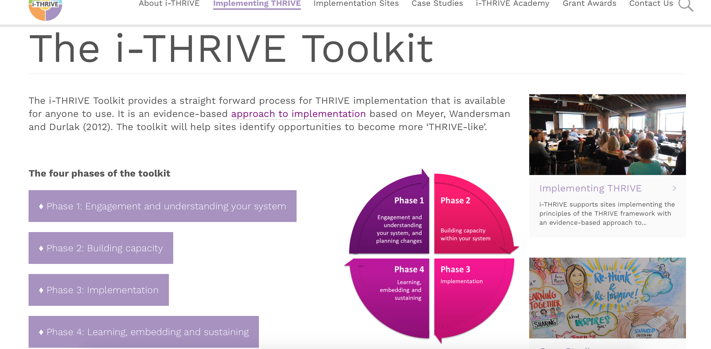
Support for sites implementing THRIVE
Website at www.implementingthrive.org
i-THRIVE Community of Practice member with access to shared learning events
i-THRIVE Academy; four training modules funded by Health Education England
i-THRIVE Illustrated; a series of case studies highlighting how different sites have approached the implementation of THRIVE
i-THRIVE Toolkit; a range of tools to support an evidence based approach to implementation

Slide 10
Overview of the THRIVE conceptual framework Dr Rachel James i-THRIVE Clinical Lead THRIVE Author

Slide 11
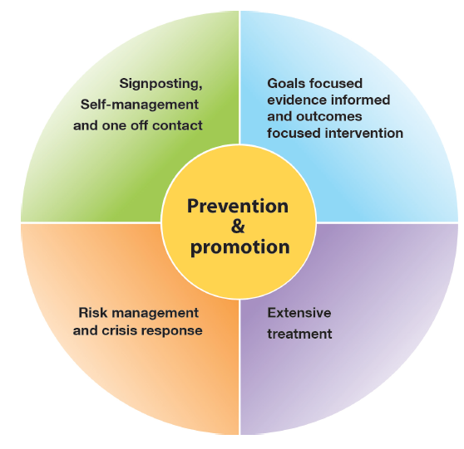
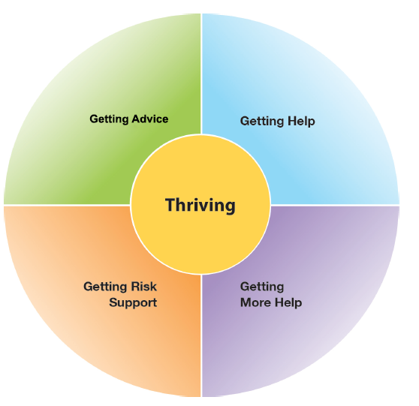
The THRIVE Conceptual Framework
Input offered
Description of the THRIVE-groups
Distinction between advice/support and evidence based ‘treatment’
Five Needs Based Groups are distinct in terms of the:
needs and/or choices of the individuals within each group
skill mix of professionals required to meet these needs
resources required to meet the needs and/or choices of people in that group

Slide 12
The THRIVE Conceptual Framework:
An Overview by Prof Miranda Wolpert, Lead THRIVE Author
https://youtu.be/t8MToMwxKqA

Slide 13
The THRIVE Conceptual Framework: Latest Iteration (November 2016)
THRIVE: The AFC-Tavistock Model for CAMHS (Wolpert et al., 2014)
THRIVE Elaborated (Wolpert et al., 2015)
An updated version with greater elaboration on key points
THRIVE Elaborated (Second Edition) (Wolpert et al., 2016)
New foreword that aims to address the most common question raised in relation to THRIVE:
“THRIVE reads as being very health focused, even though it professes to be a multi-agency framework. Can you clarify in what sense this is a genuinely multi-agency framework?”
Notes:
THRIVE is a needs based model that enables care to be provided according to four distinct groupings, determined by a patient’s needs and preferences for care
Emphasis is placed on prevention and the promotion of mental health and wellbeing
Children and young people are empowered to be actively involved in decisions about their care through shared decision making
It provides a clearer distinction than before between:
treatment and support
self-management and intervention
more systematic integration of shared decision making and routine collection of preference data
THRIVE is all about building resilience

Slide 14
The THRIVE Conceptual Framework: Latest Iteration (November 2016)
THRIVE was originally authored by professionals involved in mental health support for children and young people, all of whom came from a health background.
THRIVE Elaborated (Second Edition) now has co-authors from the world of education and social care, and have drawn on views from head teacher panels, CCG leads and local authority directors.
Highlights four key ways in which the THRIVE framework is inherently multi-agency:
1. THRIVE endorses multi-agency definitions of mental health promoting practices
2. THRIVE encourages shared multi-agency responsibility for promoting “thriving”
3. THRIVE promotes multi-agency proactive “advice” and “help”
4. THRIVE supports multi-agency clarity on endings as well as beginnings
Notes:
THRIVE is a needs based model that enables care to be provided according to four distinct groupings, determined by a patient’s needs and preferences for care
Emphasis is placed on prevention and the promotion of mental health and wellbeing
Children and young people are empowered to be actively involved in decisions about their care through shared decision making
It provides a clearer distinction than before between:
treatment and support
self-management and intervention
more systematic integration of shared decision making and routine collection of preference data
THRIVE is all about building resilience

Slide 15
The THRIVE Conceptual Framework: Summary
The THRIVE framework:
replaces tiers with a whole system approach
is based on the identified needs of children, young people and their families
advocates the effective use of data to inform delivery and meet needs
identifies groups of children and young people and the sorts of support they need
draws a clearer distinction between treatment and support
builds on individual and community strengths wherever possible
ensures children, young people and their families are active decision makers

Slide 16
The THRIVE Conceptual Framework: Needs Groups
There are 5 needs-based groups set out in the THRIVE framework:
Thriving: prevention and promotion in the community
Getting Advice and Signposting: signposting, self management and one off contact
Getting Help: goals focused, evidence informed, outcomes focused intervention
Getting More Help: extensive treatment
Getting Risk Support: focus of intervention is providing risk management

Slide 17
The THRIVE Conceptual Framework: Severity and Need
THRIVE groups are not distinguished by severity or type of problem.
Although it is likely that certain problems or severities may be more common in some THRIVE groups, there is no one-to-one relation between severity or type of problem and needs-based grouping. For example, its not possible to say all children and young people suffering with mild depression will be in the ‘getting help’ group, as they may prefer to get advice about their condition and how to manage it themselves.
Groups are organised around the different types of supportive activities provided to children and young people by mental health services and are strongly influenced by client choice.

Slide 18
THRIVE: A Conceptual Framework Overview of the needs based groupings Dr Rachel James i-THRIVE Clinical Lead THRIVE Author

Slide 19
Thriving: The Theory
Context: All children, young people and their families not currently needing individualised mental health advice or help are considered to be thriving. THRIVE would suggest that this group receive community initiatives that support mental wellness, emotional wellbeing and resilience of the whole population.
Data: It is anticipated that around 80-90% of the total population of children and young people will fall into the needs-based grouping of thriving. This is based on Green et al’s (2005) view that around 10-20% of children and young people have problems significant enough to warrant specialist help.
Resource: No economic evaluations can robustly guide policy. Reports from current practice suggest that in many areas around 10-15% of the budget in children and young people’s metal health services is allocated to support community resilience programmes; consultation with teachers, health visitors and others; and other forms of intervention to support widespread wellbeing and mental health.
Provision: The THRIVE framework expects that the system actively applies research evidence of the kind of interventions that are likely to reduce the risk of developing mental health difficulties and promote wellbeing and mental health. Opler et al (2010) define categories of prevention that might be seen to fit with the THRIVE framework of primary prevention:
Universal prevention: Targeting the general public or a population group that has not been identified on basis of individual risk
Selective prevention: Targeting individuals or population subgroups who have risk factors placing them at a higher than average risk of developing mental health problems.

Slide 20
Thriving: In Practice
Linking with public health, local communities and a wide range of agencies required to promote wellbeing
Consideration required on how information will be disseminated through schools, online, youth programmes etc
Potential opportunity to incorporate Thriving into existing assessment and intervention mechanisms such as ‘redbooks’
Produce top tips to Thriving which can be disseminated across the system

Slide 21
Getting Advice and Signposting: The Theory
Context: The children, young people and families who may require temporary support within the community or advice to self-manage long-term conditions for those who choose to do so.
Data: The modal number of sessions of children, young people and families in CAMHS is one. Practitioner reports suggest that some find just a single contact with services enough to normalize behavior and provide them with reassurance they are doing the right things to resolve the problem.
Resource: If it is estimated that 30% of children and young people needing specialist support would benefit from only small amount of resource, then this group would account for 8% of total resource.
Provision: The support provided in ‘getting advice’ can be provided in a range of settings including health, local authority, social care and third sector. Input should involve some of the most experienced workforce to determine how best to help. Local databases can help to identify relevant community and digital resources. Support should build on existing family resources and self-efficacy promoted through information provision. THRIVE suggests an invitation to re-contact services after advice is given in case things do not improve could be made.

Slide 22
Getting Advice and Signposting: In Practice
Breaking down barriers, linking services to provide integrated care
Lots of people are stuck in services with nowhere to go - there is a need for better communication and clearer interventions
Early guidance to ensure the right treatment and the right time
Focusing on early intervention to build resilience and influence outcome positively
Expert assessment and signposting
Better utilisation of outcomes to sensibly drive change

Slide 23
Getting Help: The Theory
Context: The children, young people and families who would benefit from focused, evidence-based treatment.
Data: Of the 60% of children, young people and their families who were assigned to ‘getting help’ only half were aligned to specific NICE guidance.
Resource: The mean number of face-to-face contacts was seven for this group.
Provision: The THRIVE model places a greater emphasis on ending interventions when they are not working. Input might draw on specialised technicians in different treatments. Treatment would involve explicit agreement from the beginning about the outcome being worked towards and the likely timeframe. There would be a plan for what happens if it is not achieved.

Slide 24
Getting More Help: The Theory
Context: The children, young people and families who would benefit from extensive long-term treatment. Some conditions such as psychosis, eating disorders and emerging personality disorders are likely to require this input.
Data: This group makes up 5% of children, young people and their families receiving input, but accounted for 39% of appointments. The average number of appointments attended is estimated to be around ten.
Resource: The range of costs within the group is likely to be very wide.
Provision: More procedurally defined interventions could be provided by less highly trained practitioners than are required for ‘getting advice’.

Slide 25
Getting Help and Getting More Help: In Practice
Establishing a common language
Importance of evidence based practice
Need for high quality outcomes which help to build an evidence base
The need for more defined interventions rather than open ended treatment
Better communication across physical health, social care etc

Slide 26
Risk Support: The Theory
Context: These are the children, young people and families for who evidence-based treatment are not demonstrating changes in outcomes. Severe needs, often long-term, cross-generational, with minimal resources (financial and human), limited capacity to cope with ordinary if sometimes severe family and life pressures, poor problem solving skills, lack of intra-familiar social support, negative constructions of statutory systems, compounded by significant mental health issues, particularly substance misuse (alcohol), domestic violence and physical health problems.
Data: It is estimated that this group account for 5-10% of all young people currently accessing services, although it is currently hard to differentiate them from children, young people and families receiving interventions from ‘getting help’ and ‘getting more help’.
Resource: Practitioner reports suggest this group requires significant input, time and energy. Many may be being offered intensive treatments but not attending appointments and/or not making progress. They may routinely go into crisis or self-harm.
Provision: The THRIVE model suggests there needs to be close interagency collaboration and clarity on who is responsible.

Slide 27
Risk Support: In Practice
Whole system change required with buy in from key stakeholders
Would enable better support for staff with complex cases
Shared responsibility across agencies
Supporting cases that aren’t traditionally in each other’s territories
Facilitating conversation with patients to help them identify their own needs
Early guidance to ensure right treatment and right time
Better utilisation of outcomes to sensibly drive change

Slide 28
FAQ: What’s the difference between Getting More Help and Getting Risk Support?
Getting help or more help
Getting risk support
evidence-based, carefully designed and tested for fidelity
aim of recovery, or goal of improvement expected to enhance wellbeing
participants committed to achieving change
focused activity with predetermined timeframes
structured with a theoretical rationale based on understanding of the disorder
modification to the treatment protocol is indicated by session by session treatment response
individually tailored support based on an explicit collaborative shared plan for each family
aim of reducing the risk of harm, catastrophic outcomes (death, injury) and decreasing the chance of deterioration as well as increasing self-management, resilience and agency
participants committed to improving their reactions to crises
ongoing process dependent on the young person’s needs
pragmatically driven; family to influence structure and content of the intervention within legal constraints
modification to the agreed protocol is a regular occurrence in response to the safety outcomes achieved

Slide 29
Q & A: your thoughts on the THRIVE conceptual framework i-THRIVE Team

Slide 30
Core principles and components of the i-THRIVE model of care Dr Rachel James i-THRIVE Clinical Lead THRIVE Author

Slide 31
Key Principles of an i-THRIVE Model of Care
Core THRIVE principles delivered using evidence based approaches to delivery that fit the local context
Needs based care (not severity or diagnosis led)
Shared decision making at each point in pathway
Integration: multiagency teams that are trained and located together, with common processes and outcome frameworks
Training clinicians to:
have clarity about when treatment is being provided vs. support
promote and support self help
enable shared decision making

Slide 32
i-THRIVE is a ‘Whole-Systems Approach’
Delivering good quality care that is efficient cannot be achieved successfully by looking at a single service or set of professionals, rather it needs to consider all the parts of the system.
This involves not only thinking about all the agencies that are involved in providing services, but also considering how well the different ‘levels’ of the system are working together.
One way of thinking about these levels is to think about it in terms of three parts, all of which are dependent on each other and interact with each other.
These are the ‘Macro’, ‘Meso’ and ‘Micro’ systems.
THRIVE focuses on providing care according to the needs of young people, and helps services to provide that care according to those needs identified.
Given this, when developing a view of the system, it is necessary to understand which patient groups that are being considered at each level in the system, as well as the services that are providing care to that patient group at that level.

Slide 33
Consideration of the Different System ‘Levels’
MACRO
Consideration of Population Health Improvement
How agencies work together and commission services for the population
MESO
Needs based groups of young people and the services/ teams that enable delivery of care according to those needs
MICRO
Ways of working with young people and their families, and how professionals can work best in a collaborative and integrated way

Slide 34
Consideration of the Different System ‘Levels’

Slide 35
Identifying the Population Groups and Services within the System Levels
 | Young People | Services | Example
Macro System | All young people within a locality | Commissioners (Health, Social Care and Education) Agencies that deliver care (Health, Local Authority, Education, Independent and Third Sectors) | CCG, Council NHS Trust, Council, Young Minds
Meso System | Needs based groups of young people who require care for a mental health concern. These are the five needs based groups identified in THRIVE. | The services that provide care for these needs based groups of young people. | SPA, ADHD services, locality teams, school counselling services
Micro System | Individual young people receiving care for a mental health concern | The teams and individuals within those teams for provide care for young people in their services. | Individual therapists giving CBT Members of the single point of access assessment team in a particular setting.

Slide 36
Possible Components of an i-THRIVE Model of Care
Getting Advice and Signposting
Getting Help
Digital ‘front – end’
Short, evidence based interventions aligned with NICE Guidance
Single point of access with multi-agency assessment & effective signposting
Creating a comprehensive network of community providers: Youth Wellbeing Directory
CYP IAPT
Wide variety of choice of modality and location, provided by health or alternatives (3rd sector, community providers)
Outreach to Hard-to-reach groups
Schools and primary care in-reach
Self-help and peer-support
Outcomes plus goal based measures
AMBiT: Integrated multi-agency approach with joint accountability for outcomes
Longer, evidence based interventions
Safety plans co-produced between agencies & young people
CYP IAPT
Provided by health primarily
Emphasis on developing Personal support network
Outcomes plus goal based measures
Self-help and peer-support
Getting More Help
Risk Support

Slide 37
i-THRIVE Approach to Implementation Emma Louisy i-THRIVE Programme Manager

Slide 38
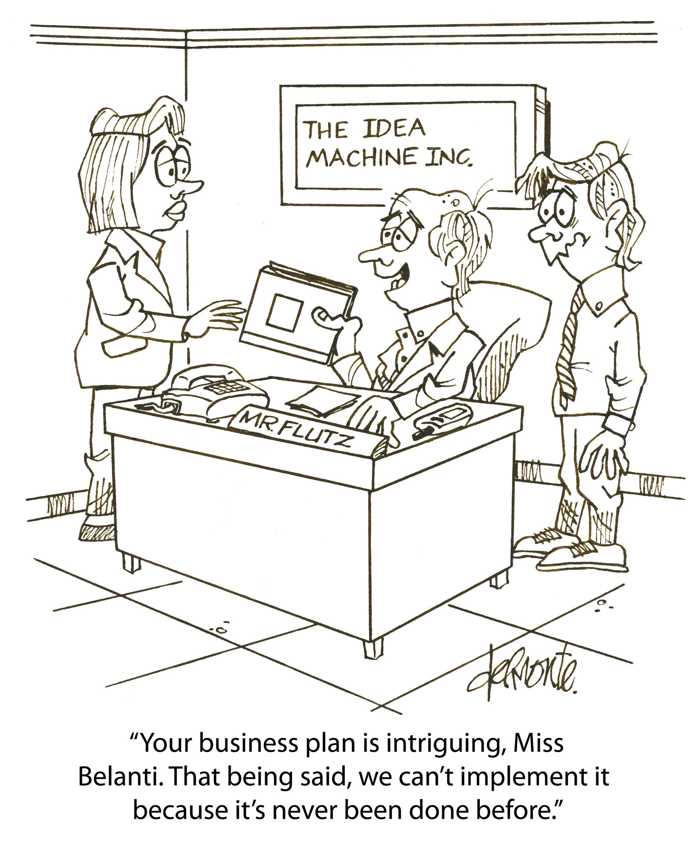
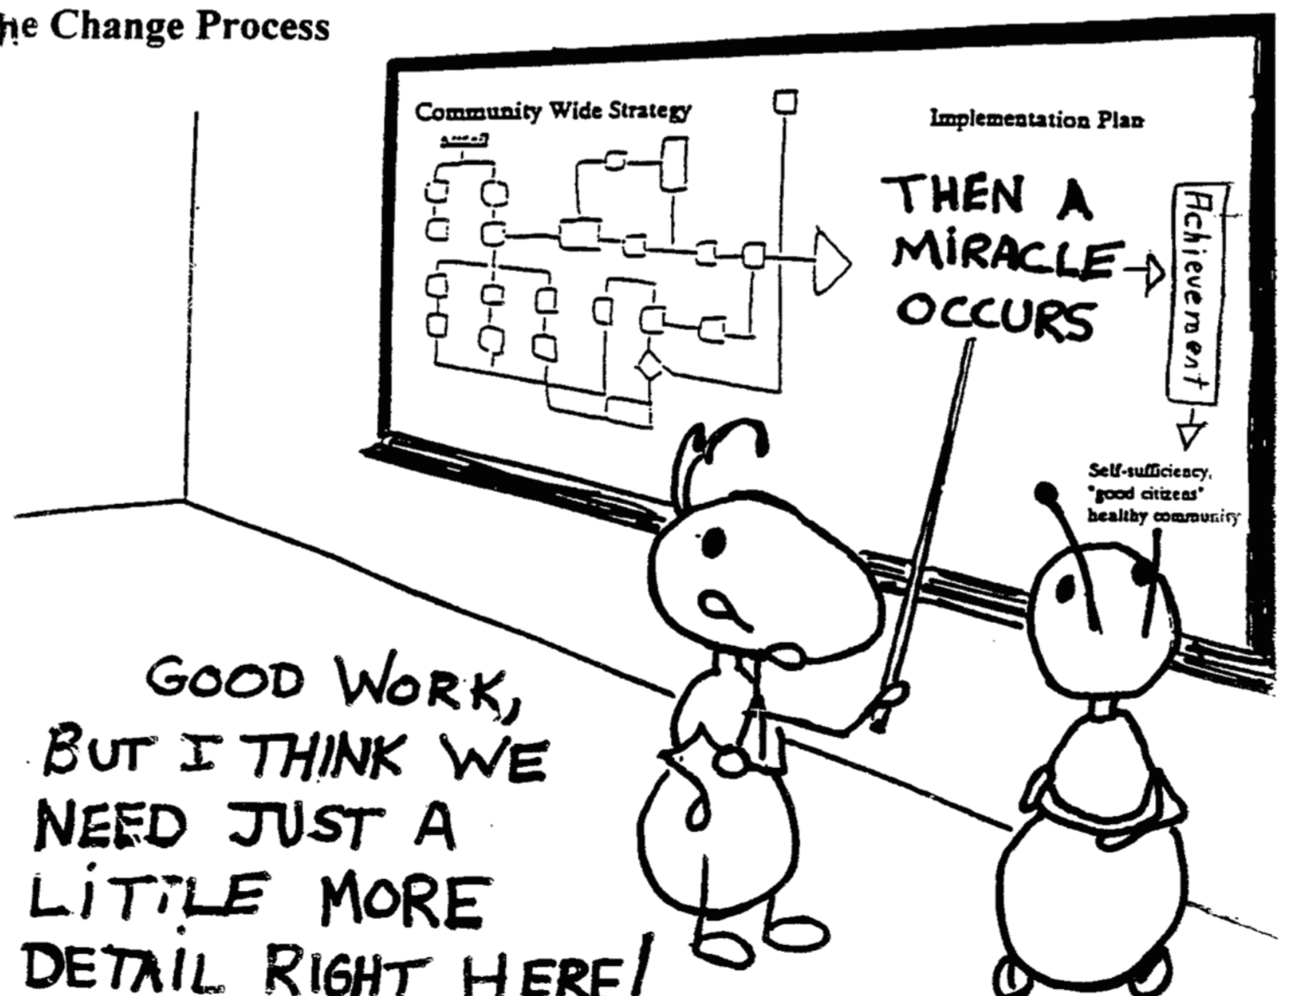
Approach to Implementation

Slide 39
What problem are we trying to solve?
We get ‘THRIVE’ and think it is a good idea….. But how do we actually ‘do’ it?!
Lots of change models; all have advantages and disadvantages
These models provide a set of steps that can help sites navigate through a complex change process
Successful implementation is also dependent on a range of contextual factors including: leadership, local approach, culture, funding, local starting point…
There is a growing evidence base about what helps an implementation project to be successful
This is described in the ‘Implementation Science’ or ‘Improvement Science’ literature
The i-THRIVE Approach to Implementation draws on this evidence base set out in the literature to provide an approach that is locally led, co-created, pragmatic, evidence based and is designed to address local context

Slide 40
Taking an evidenced based approach to implementation with the Quality Implementation Framework
Set up and governance
Engagement
Understanding your system
Prioritisation
Re-design
Implementation Planning
Structural features of Implementation
Developing Implementation teams
Workforce planning
Community of Practice
Training Clinical and Professional teams
Measurement in place
Phase 1
Phase 2
Engagement, understanding your system, and planning
Building capacity within your system
Learning from
Experience
Sustainability
Normalisation
Process Theory
Ongoing Implementation Support Strategies
Making changes – use of Quality Improvement
Technical Assistance /Coaching/Supervision in Change Management
Supportive Feedback Mechanisms
Phase 4
Phase 3
Learning, embedding & sustaining
Implementation

Slide 41
Taking an evidenced based approach to implementation with the Quality Implementation Framework
Set up and governance
Engagement
Understanding your system
Prioritisation
Re-design
Implementation Planning
Structural features of Implementation
Developing Implementation teams
Workforce planning
Community of Practice
Training Clinical and Professional teams
Measurement in place
3-4 months
3-6 months
Phase 1
Phase 2
Engagement, understanding your system, and planning
Building capacity within your system
Learning from
Experience
Sustainability
Normalisation
Process Theory
Ongoing Implementation Support Strategies
Making changes – use of Quality Improvement
Technical Assistance /Coaching/Supervision in Change Management
Supportive Feedback Mechanisms
Phase 4
Phase 3
Learning, embedding & sustaining
Implementation
2 months – on going
1 year cycles

Slide 42
Phase 1: Understanding Your System and Agreeing Your Priorities
1. Establishing a team who will oversee this process
Senior oversight, includes commissioners and providers of health, care and education.
2. Initial engagement with the system
Communication and engagement across the system, from senior leadership to team leads and those working with children and young people day to day.
Aim for agreement from the system, to increase awareness of issues as well as understanding of the possible approaches to improvement.
3. Analysis of your existing systems
Pathway Mapping
Data Analysis
Qualitative Understanding
4. THRIVE Baseline: How THRIVE-like are we currently?
5. Agreeing priorities for improvement
What are our collective aims?
What are the priority areas that will help us improve on these areas?
6. Transformation Design and Implementation Planning

Slide 43
Phase 1: Understanding Your System and Agreeing Your Priorities – TOOLS AVAILABLE
Pathway Mapping
Slide set and agenda to host a ‘pathway mapping’ workshop in your locality
Understanding your Data
Interview questions for qualitative data collection from key individuals within your system
Data requirements list for the quantitative data to be collected from your system
Slide set and agenda to host an ‘understanding your data’ workshop in your locality
Gap Analysis
Slide set and tool to assess the gaps in your current system and the steps that need to be taken in order to address your agreed priorities
THRIVE Assessment Tool
Slide set and tool to assess how THRIVE-like your system is currently
Redesign
Slide set and agenda to host a ‘redesign’ workshop in your locality
Prioritising Improvement
Slide set and agenda to host a ‘prioritising improvement’ workshop in your locality
All tools available at www.implementingTHRIVE.org

Slide 44
Q & A: your thoughts on the i-THRIVE programme i-THRIVE Team

Slide 45
For more information: i-THRIVE
www.implementingthrive.org
Twitter @iTHRIVEinfo

Slide 46
For more information: the i-THRIVE Programme Team
Anna Moore:
i-THRIVE Lead
a.moore@ucl.ac.uk
Emma Louisy:
i-THRIVE Programme Manager
ELouisy@Tavi-Port.nhs.uk
Rachel James:
i-THRIVE Clinical Lead
rjames@tavi-port.nhs.uk
Ilse Lee:
Senior Research Assistant and Community of Practice Manager
Ilse.Lee@annafreud.org
Currently on Maternity Leave

