Slide 1
Implementing THRIVE Phase 1: Developing a full understanding of your current system
“If we keep on doing what we have been doing, we are going to keep on getting what we have been getting”

Slide 2
Agenda
Overview of THRIVE and i-THRIVE
i-THRIVE Approach to Implementation
Phase 1: Understanding your system
Mapping your pathways
Determine the scope of the pathway
Build the shape of the pathway
Group analysis of the pathway
Next steps

Slide 3
Overview of THRIVE and i-THRIVE

Slide 4
THRIVE & i-THRIVE
The THRIVE conceptual framework was developed as a collaboration between the Anna Freud National Centre for Children and Families and the Tavistock and Portman NHS Foundation Trust.
i-THRIVE is the implementation programme that supports sites to translate the THRIVE conceptual framework into a model of care that fits local context.
The i-THRIVE programme is a collaboration between the Anna Freud National Centre for Children and Families, the Tavistock and Portman NHS Foundation Trust, Dartmouth Institute for Health Policy and Clinical Practice (US), and UCLPartners.

Slide 5
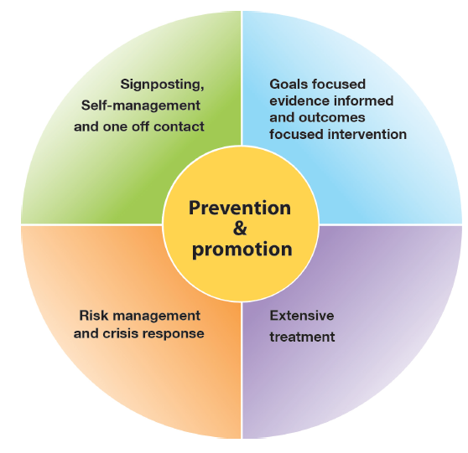
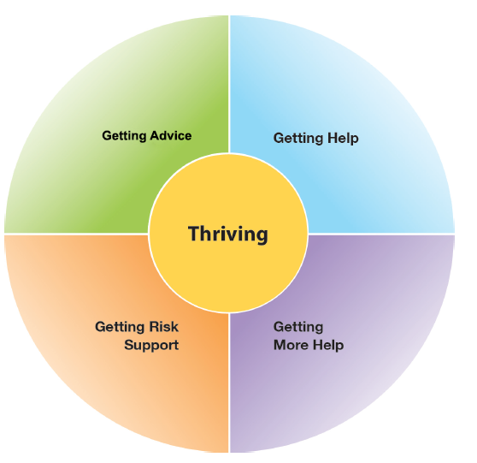
The THRIVE Conceptual Framework
Input offered
Description of the THRIVE-groups
Distinction between advice/support and evidence based ‘treatment’
Five Needs Based Groups are distinct in terms of the:
needs and/or choices of the individuals within each group
skill mix of professionals required to meet these needs
resources required to meet the needs and/or choices of people in that group

Slide 6
The THRIVE Conceptual Framework:
An Overview by Prof Miranda Wolpert, Lead THRIVE Author
https://youtu.be/t8MToMwxKqA

Slide 7
The THRIVE Conceptual Framework: Latest Iteration (November 2016)
THRIVE: The AFC-Tavistock Model for CAMHS (Wolpert et al., 2014)
THRIVE Elaborated (Wolpert et al., 2015)
An updated version with greater elaboration on key points
THRIVE Elaborated (Second Edition) (Wolpert et al., 2016)
New foreword that aims to address the most common question raised in relation to THRIVE:
“THRIVE reads as being very health focused, even though it professes to be a multi-agency framework. Can you clarify in what sense this is a genuinely multi-agency framework?”

Slide 8
The THRIVE Conceptual Framework: Latest Iteration (November 2016)
THRIVE was originally authored by professionals involved in mental health support for children and young people, all of whom came from a health background.
THRIVE Elaborated (Second Edition) now has co-authors from the world of education and social care, and have drawn on views from head teacher panels, CCG leads and local authority directors.
Highlights four key ways in which the THRIVE framework is inherently multi-agency:
1. THRIVE endorses multi-agency definitions of mental health promoting practices
2. THRIVE encourages shared multi-agency responsibility for promoting “thriving”
3. THRIVE promotes multi-agency proactive “advice” and “help”
4. THRIVE supports multi-agency clarity on endings as well as beginnings
Copies of the new foreword are available for you to take away with you today.

Slide 9
THRIVE and i-THRIVE
The THRIVE conceptual framework was developed as a collaboration between the Anna Freud National Centre for Children and Families and the Tavistock and Portman NHS Foundation Trust.
i-THRIVE is the implementation programme that supports sites to translate the THRIVE conceptual framework into a model of care that fits local context.
The i-THRIVE programme is a collaboration between the Anna Freud National Centre for Children and Families, the Tavistock and Portman NHS Foundation Trust, Dartmouth Institute for Health Policy and Clinical Practice (US), and UCLPartners.

Slide 10
i-THRIVE Programme
The i-THRIVE programme was developed in response to the demand for support with implementation of the THRIVE conceptual framework
i-THRIVE supports sites to translate the THRIVE conceptual framework into a model of care that fits local context
The programme was created thanks to its recognition as an NHS Innovation Accelerator, led by Dr Anna Moore

Slide 11
Aligned to existing programmes
The i-THRIVE programme complements existing transformation and Quality Improvement programmes in the NHS
Builds on local strengths across whole system

Slide 12
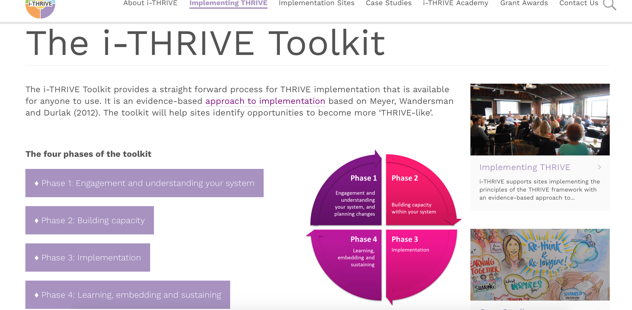
Support for sites implementing THRIVE
Website at www.implementingthrive.org
i-THRIVE Community of Practice member with access to shared learning events
i-THRIVE Academy; four training modules funded by Health Education England
i-THRIVE Illustrated; a series of case studies highlighting how different sites have approached the implementation of THRIVE
i-THRIVE Toolkit; a range of tools to support an evidence based approach to implementation

Slide 13
Core principles and components of the i-THRIVE model of care

Slide 14
i-THRIVE : possible components of an i-THRIVE Model of Care
Getting Advice and Signposting
Getting Help
Digital ‘front – end’
Short, evidence based interventions aligned with NICE Guidance
Single point of access with multi-agency assessment & effective signposting
Creating a comprehensive network of community providers: Youth Wellbeing Directory
CYP IAPT
Wide variety of choice of modality and location, provided by health or alternatives (3rd sector, community providers)
Outreach to Hard-to-reach groups
Schools and primary care in-reach
Self-help and peer-support
Outcomes plus goal based measures
AMBiT: Integrated multi-agency approach with joint accountability for outcomes
Longer, evidence based interventions
Safety plans co-produced between agencies & young people
CYP IAPT
Provided by health primarily
Emphasis on developing Personal support network
Outcomes plus goal based measures
Self-help and peer-support
Getting More Help
Risk Support
Notes:
One question often raised by sites looking at how to implement THRIVE was what would a THRIVE-like service or system look like in practice? The i-THRIVE programme suggests a set of components that as a whole would make up an i-THRIVE model of care; with specific requirements for the needs based groupings. For instance, there should be a digital front end to support children and young people looking for advice and signposting, while all evidence based interventions delivered as part of ‘getting help’ and ‘getting more help’ should be in line with CYPIAPT and have agreed goal based outcomes.

Slide 15
i-THRIVE Approach to Implementation Phase 1: Understanding Your System

Slide 16
i-THRIVE Approach to Implementation: process of implementation
Set up and governance
Engagement
Understanding your system
Prioritisation
Re-design
Implementation Planning
Structural features of Implementation
Developing Implementation teams
Workforce planning
Community of Practice
Training Clinical and Professional teams
Measurement in place
3-4 months
3-6 months
Phase 1
Phase 2
Engagement, understanding your system, and planning
Building capacity within your system
Learning from
Experience
Sustainability
Normalisation
Process Theory
Ongoing Implementation
Support Strategies
Making changes – use of Quality Improvement
Technical Assistance /Coaching/Supervision in Change Management
Supportive Feedback Mechanisms
Phase 4
Phase 3
Learning, embedding and sustaining
Implementation
2 months – on going
1 year cycles

Slide 17
Phase 1: Understanding Your System and Agreeing Your Priorities
1. Establishing a team who will oversee this process
Senior oversight, includes commissioners and providers of health, care and education.
2. Initial engagement with the system
Communication and engagement across the system, from senior leadership to team leads and those working with children and young people day to day.
Aim for agreement from the system, to increase awareness of issues as well as understanding of the possible approaches to improvement.
3. Analysis of your existing systems
Pathway Mapping
Data Analysis
Qualitative Understanding
4. THRIVE Baseline: How THRIVE-like are we currently?
5. Agreeing priorities for improvement
What are our collective aims?
What are the priority areas that will help us improve on these areas?
6. Transformation Design and Implementation Planning

Slide 18
Detail of Delivery of Phase 1
Set up and communication across the whole system
Series of three workshops
Pathway Mapping and Analysis
Understanding system together, THRIVE Assessment and Prioritisation
Re-design
Data gathering
Quantitative: how is the system performing?
Qualitative: what are the perceived strengths and weaknesses? (staff & CYP)
Pathway structures
Workforce Analysis
Outputs
Phase 1 analysis report and Implementation plan

Slide 19
i-THRIVE Approach to Implementation Phase 1: Understanding Your System Mapping Your Pathways

Slide 20
Aim of the Pathway Mapping Exercise
THRIVE is a whole system, integrated approach to care that aims to integrate health, social care and education systems, and to understand how independent and third sector (voluntary) organisations play a part in caring for young people.
Mapping your existing pathways today will:
Help each member of the team understand the complete pathway, including those steps that may not involve them directly
Help you to understand how each service is working and how well they work together
Identify areas where the process does and does not work well
Provide an end product for the next step of the process

Slide 21
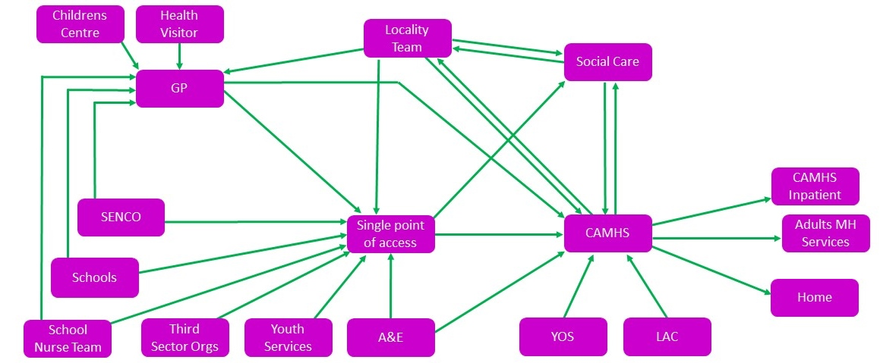
Overall structure of the sessions today
First session (1 hour):
Determine the scope of the pathway
Build the shape of the pathway
Second session (1 hour):
Group analysis of the pathway

Slide 22
Determine the Scope of the Pathway
The purpose of this exercise is to identify all parts of the pathway.
15 minutes
Within your group identify the services that exist in your locality that are involved in caring for children and young people’s mental health.
Referrers into CAMHS
CAMHS services and teams
Local authority services and teams
Educational settings
Online/digital services
Charities
Third sector organisations
Support for carers
Write each service on an individual post it note
Begin to think about the possible starting points and ending points for your pathways as they exist now.

Slide 23
Building the Shape of your Pathway
Group Work
The purpose of this part is to develop an agreement about the structure of your existing pathways.
30 minutes
Each of the services have been written on a post it note.
Within your group, start to place these on the white sheet in a way that depicts the flow of children and young people through your services currently.
Using the arrows (straws!) indicate the possible directions of flow between services.
(Example pathway on next slide)

Slide 24
Example Pathway
If possible, expand on these – e.g. what pathways do you have within CAMHS ?
Start another diagram if needed/easier

Slide 25
Building the Shape of your Pathway
Review and consensus building
The purpose of this part is to review the pathways that you have outlined as a group and then build a consensus about what you have set out.
30 minutes
Review the pathways mapped by the group.
If there are alternative pathways identified by different members of staff discuss until there is agreement
This is repeated iteratively until all parts of the pathway have been mapped and agreed on.

Slide 26
Group Analysis of the Pathway
The current pathway structure can be the result of multiple re-organisations, services that are either added on or taken away because of funding or perceived need, or due to changes in quality standards.
Review of a pathway and the interactions between services and agencies can highlight good practice and areas that could be improved due to problems in quality or efficiency.
Review the pathway from four different perspectives to get a clearer understanding of good practice and areas for improvement.

Slide 27
Group Analysis of the Pathway
Review of the pathway from four perspectives
Review from the perspective of:
Patient experience
Operations (interactions between services and agencies)
Evidenced based interventions
Outcomes and measures
For each perspective, assess the pathway as it exists and highlight areas of:
Good practice
Problems with quality
Problems with duplication and inefficiency.
The observations made by the group will be written next to the relevant services and/or flow of pathway so that the results of your review are captured clearly

Slide 28
Group Analysis of the Pathway
Review of the pathway from four perspectives
15 minutes
Patient experience
If you were a young person or a family member how easy would it find you find it to navigate the pathway?
What structures are there in place to gather insight and feedback from young people and families?
Remember to highlight areas of:
Good practice
Problems with quality
Problems with duplication and inefficiency.

Slide 29
Group Analysis of the Pathway
Review of the pathway from four perspectives
15 minutes
Operations (interactions between services and agencies)
Are there any particular bottlenecks within the pathway?
Are there points within the pathway that have longer waiting lists than others?
How easy is it to access services at different points of the pathway?
Are there multiple assessments at multiple stages of the pathway?
Remember to highlight areas of:
Good practice
Problems with quality
Problems with duplication and inefficiency.

Slide 30
Group Analysis of the Pathway
Review of the pathway from four perspectives
15 minutes
Evidence based interventions
Are the services delivered to young people in the ‘Getting Help’ and ‘Getting More Help’ needs groups compliant with NICE guidelines? Are they delivered by people trained in that therapy and who are adequately supervised?
What systems are in place to give you confidence to know that the above is in place?
What level of scrutiny of interventions is there in non-health settings?
Remember to highlight areas of:
Good practice
Problems with quality
Problems with duplication and inefficiency.

Slide 31
Group Analysis of the Pathway
Review of the pathway from four perspectives
15 minutes
Outcomes and measures
Do your clinicians routinely collect and use outcome measures? Is there variation in practice? Is this data used in supervision?
Is data used to make decisions about service delivery? Are there structures in place to review data and discuss improvements?
Is service data ever fed back to clinicians?
Do commissioners and providers agree outcomes and measures collaboratively?
Remember to highlight areas of:
Good practice
Problems with quality
Problems with duplication and inefficiency.

Slide 32
Next steps
The agreed understanding of the current pathways will be translated into a document and shared with the attendees today
Next steps will be to bring together this pathway, plus the data about how this pathway is functioning, as well as qualitative feedback from you and patients about the pathways
This will be used to undertake a thorough baselining exercise of how THRIVE-like your pathways currently are.
You will then be able to determine the areas for prioritisation and to develop a view of your ideal pathway

Slide 33
For more information: i-THRIVE
www.implementingthrive.org
Twitter @iTHRIVEinfo

Slide 34
For more information: the i-THRIVE Programme Team
Anna Moore:
i-THRIVE Lead
a.moore@ucl.ac.uk
Emma Louisy:
i-THRIVE Programme Manager
ELouisy@Tavi-Port.nhs.uk
Rachel James:
i-THRIVE Clinical Lead
rjames@tavi-port.nhs.uk
Ilse Lee:
Senior Research Assistant and Community of Practice Manager
Ilse.Lee@annafreud.org
Currently on Maternity Leave

