Slide 1
Implementing THRIVE Phase 1: Developing a full understanding of your current system
“If we keep on doing what we have been doing, we are going to keep on getting what we have been getting”

Slide 2
Our Presentation Today
Overview of THRIVE and i-THRIVE
Phase 1: Understanding your system
THRIVE Assessment Tool
Top Line Prioritisation

Slide 3
Overview of THRIVE and i-THRIVE

Slide 4
The THRIVE Conceptual Framework
The THRIVE conceptual framework (Wolpert, et al. 2016) was developed as a collaboration between the Anna Freud National Centre for Children and Families and the Tavistock and Portman NHS Foundation Trust.
Built on learning from:
Child Outcomes Research Consortium (CORC); use of patient reported outcome measures to transform practice: www.corc.uk.net
Choice and Partnership Approach (CAPA); how to manage flow and embed shared decision making: http://capa.co.uk/
Payment Systems in CAMHS development; 19 case mix adjusted groupings: http://pbrcamhs.org/final-report-published/
Notes:
Rachel

Slide 5
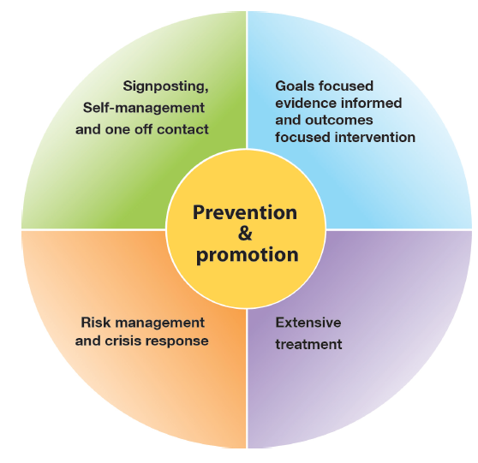
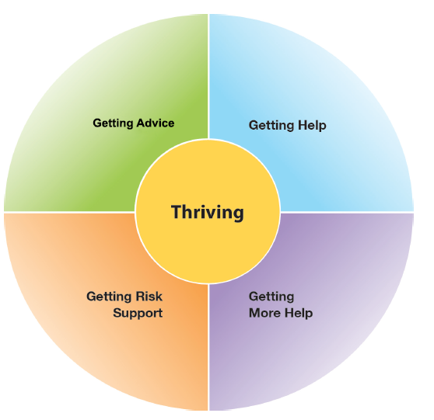
The THRIVE Conceptual Framework
Input offered
Description of the THRIVE-groups
Distinction between advice/support and evidence based “treatment”
The five needs based groups are distinct in terms of the:
needs and/or choices of the individuals within each group
skill mix of professionals required to meet these needs
resources required to meet the needs and/or choices of people in that group
THRIVE Elaborated, Second Edition (Wolpert et al., 2016)
Notes:
Rachel

Slide 6
THRIVE Key Principles
Shared decision making at heart of choice
Acknowledgment of limitation of evidence-based interventions
Acknowledgment of limitations of resources
Distinction between getting help (“treatment”) and risk support
Greater emphasis on how to help young people and communities build on their own strengths
THRIVE Elaborated, Second Edition (Wolpert et al., 2016)
Notes:
Rachel

Slide 7
The THRIVE Conceptual Framework: Latest Iteration (November 2016)
THRIVE was originally authored by professionals involved in mental health support for children and young people, all of whom came from a health background.
THRIVE Elaborated (Second Edition) now has co-authors from the world of education and social care, and have drawn on views from head teacher panels, CCG leads and local authority directors.
Highlights four key ways in which the THRIVE framework is inherently multi-agency:
1. THRIVE endorses multi-agency definitions of mental health promoting practices
2. THRIVE encourages shared multi-agency responsibility for promoting “thriving”
3. THRIVE promotes multi-agency proactive “advice” and “help”
4. THRIVE supports multi-agency clarity on endings as well as beginnings
THRIVE Elaborated, Second Edition (Wolpert et al., 2016)
Notes:
Rachel

Slide 8
The response to the THRIVE Conceptual Framework
We really like the concept and principles of THRIVE and would like to use it to underpin our redesign of mental health services for children and young people in line with Future in Mind
BUT…
What do the principles look like in practice on the ground?
How do we make it work in our area?
Is there a blueprint for implementation?
How should we design services to reflect THRIVE principles?
Can we access support for implementation?
How do we implement the concepts?
Notes:
Rachel

Slide 9
i-THRIVE Programme
i-THRIVE is the implementation programme that supports sites to translate the THRIVE conceptual framework into a model of care that fits local context.
The i-THRIVE programme is a collaboration between the Anna Freud National Centre for Children and Families, the Tavistock and Portman NHS Foundation Trust, Dartmouth Institute for Health Policy and Clinical Practice, and UCLPartners.
Notes:
Rachel

Slide 10
Aligned to existing programmes
The i-THRIVE programme complements existing transformation and Quality Improvement programmes in the NHS
Builds on local strengths across whole system

Slide 11
i-THRIVE Programme: offer to sites
Evaluation
Two year evaluation of i-THRIVE for accelerator sites
i-THRIVE Academy
Learning and development support for leaders and training modules for sites
Funded projects
Individual projects to create and test shared decision making aids in Camden and to implement THRIVE in NELFT
i-THRIVE Toolkit
Evidence based tools to aid implementation
i-THRIVE Approach to Implementation
Four phase approach to implementation drawn from implementation science evidence base
i-THRIVE Community of Practice
Shared learning events and forum for sites to share experiences about implementing THRIVE
Direct support to sites
from the national programme team
THRIVE Illustrated
Series of case studies highlighting how sites have approached the implementation of THRIVE
Notes:
Emma

Slide 12
Core principles and components of the i-THRIVE model of care

Slide 13
i-THRIVE Approach to Implementation: whole system change
MACRO
Consideration of Population Health Improvement
How agencies work together and commission services for the population
MESO
Needs based groups of young people and the services/ teams that enable delivery of care according to those needs
MICRO
Ways of working with young people and their families, and how professionals can work best in a collaborative and integrated way
Notes:
Emma

Slide 14
i-THRIVE Approach to Implementation: whole system change
Notes:
Emma

Slide 15
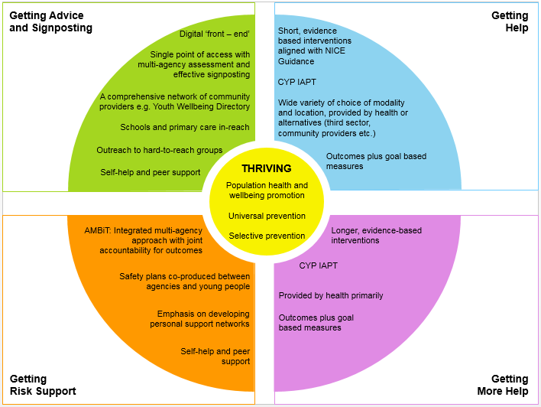
Core Components of an i-THRIVE Model of Care
Notes:
Emma

Slide 16
i-THRIVE Approach to Implementation Phase 1: Understanding Your System

Slide 17
i-THRIVE Approach to Implementation: process of implementation
Set up and governance
Engagement
Understanding your system
Prioritisation
Re-design
Implementation Planning
Structural features of Implementation
Developing Implementation teams
Workforce planning
Community of Practice
Training Clinical and Professional teams
Measurement in place
Phase 1
Phase 2
Engagement, understanding your system, and planning
Building capacity within your system
Learning from
Experience
Sustainability
Normalisation
Process Theory
Ongoing Implementation
Support Strategies
Making changes – use of Quality Improvement
Technical Assistance /Coaching/Supervision in Change Management
Supportive Feedback Mechanisms
Phase 4
Phase 3
Learning, embedding and sustaining
Implementation

Slide 18
Phase 1: Understanding Your System and Agreeing Your Priorities
1. Establishing a team who will oversee this process
Senior oversight, includes commissioners and providers of health, care and education.
2. Initial engagement with the system
Communication and engagement across the system, from senior leadership to team leads and those working with children and young people day to day.
Aim for agreement from the system, to increase awareness of issues as well as understanding of the possible approaches to improvement.
3. Analysis of your existing systems
Pathway Mapping
Data Analysis
Qualitative Understanding
4. THRIVE Baseline: How THRIVE-like are we currently?
5. Agreeing priorities for improvement
What are our collective aims?
What are the priority areas that will help us improve on these areas?
6. Transformation Design and Implementation Planning
Notes:
Not going to go through this much now, but will be sending the slides through after today

Slide 19
Detail of Delivery of Phase 1
Set up and communication across the whole system
Series of three workshops
Pathway Mapping and Analysis
Understanding system together, THRIVE Assessment and Prioritisation
Re-design
Data gathering
Quantitative: how is the system performing?
Qualitative: what are the perceived strengths and weaknesses? (staff & CYP)
Pathway structures
Workforce Analysis
Outputs
Phase 1 analysis report and Implementation plan

Slide 20
i-THRIVE Approach to Implementation Phase 1: Understanding Your System i-THRIVE Assessment Tool How THRIVE-like is your current system?

Slide 21
How THRIVE-like is our service?
An important part of developing a plan for implementation is to understand where to focus your energies and prioritise activity.
THRIVE sets out a range of core principles, many of which will be already really well implemented already in your service. Some of which may not be in place at this point in time.
Implementation of THRIVE does not involve scrapping all the good work that has already been done in your locality to provide good quality care, rather it aims to identify good practice and build on this.
The first step of this process is to analyse your existing pathways and systems, using the system analysis you have recently undertaken, to identify areas where your service is already working in a THRIVE-like way, and to identify those areas that would benefit from improvement.

Slide 22
Analysing your system taking a ‘Whole-Systems Approach’
Delivering good quality care that is efficient cannot be achieved successfully by looking at a single service or set of professionals, rather it needs to consider all the parts of the system.
This involves not only thinking about all the agencies that are involved in providing services, but also considering how well the different ‘levels’ of the system are working together.
One way of thinking about these levels is to think about it in terms of three parts, all of which are dependent on each other and interact with each other.
These are the ‘Macro’, ‘Meso’ and ‘Micro’ systems.
THRIVE focuses on providing care according to the needs of young people, and helps services to provide that care according to those needs identified.
Given this, when developing a view of the system, it is necessary to understand which patient groups that are being considered at each level in the system, as well as the services that are providing care to that patient group at that level.

Slide 23
Consideration of the Different System ‘Levels’
MACRO
Consideration of Population Health Improvement
How agencies work together and commission services for the population
MESO
Needs based groups of young people and the services/ teams that enable delivery of care according to those needs
MICRO
Ways of working with young people and their families, and how professionals can work best in a collaborative and integrated way

Slide 24
Consideration of the Different System ‘Levels’

Slide 25
Identifying the Population Groups and Services within System Levels
 | Young People | Services | Example
Macro System | All young people within a locality | Commissioners (Health, Social Care and Education) Agencies that deliver care (Health, LA, Education, Independent and Third Sectors) | CCG, Council NHS Trust, Council, Young Minds
Meso System | Needs based groups of young people who require care for a mental health concern. These are the 5 needs based groups identified in THRIVE. | The services that provide care for these needs based groups of young people. | SPA, ADHD services, locality teams, school counselling services.
Micro System | Individual young people receiving care for a mental health concern | The teams and individuals within those teams for provide care for young people in their services. | Individual therapists giving CBT. Members of the SPA assessment team in a particular setting.

Slide 26
Using the THRIVE Assessment to plan your transformation work
With a better understanding of how THRIVE-like your system currently is it is then possible to begin thinking about your plans for transformation and service improvement.
The areas scoring a 3 or 4 are working well already and should be protected during any transformation planning.
The areas scoring 1 or 2 are the main areas for improvement and are all potential areas to focus improvement efforts on.
Discussions when using the THRIVE Assessment Tool may also highlight gaps in current data or information. This can help you to establish any further data collection that needs to take place in order to truly understand your current system.
Using the THRIVE Assessment Tool at key stages throughout your transformation work will allow you to establish the progress made in implementing THRIVE in Cambridgeshire and Peterborough.

Slide 27
THRIVE Assessment Tool
THRIVE is made up of a set of core principles that relate to these three parts of the system: the macro, meso and micro system.
The THRIVE Assessment Tool explains each of these principles and provides four descriptions for each principle, which range from a very THRIVE-like system, to one that has some way to go before it can describe itself as ‘THRIVE-like’.
Group Exercise
Each table will focus on one part of the system (macro, meso or micro system) and the relevant THRIVE principles
For each of the principles, draw on the understanding of your system that you have and discuss how ‘THRIVE-like’ your system is currently. Be honest about your strengths and areas for improvement.
Circle the number that represents the best fitting description of the THRIVE principle in question for your system currently.

Slide 28
THRIVE Assessment Tool: Group Exercise
One hour
For each of the THRIVE principles, draw on the understanding of your system that you have and discuss how ‘THRIVE-like’ your system is currently. Be honest about your strengths and areas for improvement.
Circle the number that represents the best fitting description of the principle in question.
One hour
Feedback to the group as a whole what you have scored each of the THRIVE principles for your section of the system (macro, meso or micro)
Agree consensus on scoring with the other table focusing on your section of the system (macro, meso or micro)

Slide 29
Prioritisation
Now that you have assessed your current system in [enter place name] using the THRIVE Assessment Tool we can discuss:
What are your immediate thoughts around what your key priorities could be?
Are there any areas that scored poorly (scored at a 1 on the THRIVE Assessment Tool) that need to be addressed immediately?
Are there any quick wins where things are already working well (scored at a 3 on the THRIVE Assessment Tool) could be made excellent with a small amount of work?
Are there any projects or pieces of work that are already underway to address some of the principles outlined in the THRIVE Assessment Tool?
Straw poll of everyone in the room

Slide 30
Next Steps

Slide 31
Next Steps
Slides from today to be shared
Further questions? Contact [name] at [email@address]

Slide 32
For more information: i-THRIVE
www.implementingthrive.org
Twitter @iTHRIVEinfo

Slide 33
For more information: the i-THRIVE Programme Team
Anna Moore:
i-THRIVE Lead
a.moore@ucl.ac.uk
Rachel James:
i-THRIVE Clinical Lead
rjames@tavi-port.nhs.uk
Bethan Morris:
i-THRIVE Research Officer
Bethan.morris@annafreud.org

