Slide 1
Implementing THRIVE Phase 1: Developing a full understanding of your current system
“If we keep on doing what we have been doing, we are going to keep on getting what we have been getting”

Slide 2
Our Presentation Today
Overview of THRIVE and i-THRIVE
Phase 1: Understanding your system
Establishing Priorities
Gap Analysis
Next Steps

Slide 3
Overview of THRIVE and i-THRIVE

Slide 4
The THRIVE Conceptual Framework
The THRIVE conceptual framework (Wolpert, et al. 2016) was developed as a collaboration between the Anna Freud National Centre for Children and Families and the Tavistock and Portman NHS Foundation Trust.
Built on learning from:
Child Outcomes Research Consortium (CORC); use of patient reported outcome measures to transform practice: www.corc.uk.net
Choice and Partnership Approach (CAPA); how to manage flow and embed shared decision making: http://capa.co.uk/
Payment Systems in CAMHS development; 19 case mix adjusted groupings: http://pbrcamhs.org/final-report-published/
Notes:
Rachel

Slide 5
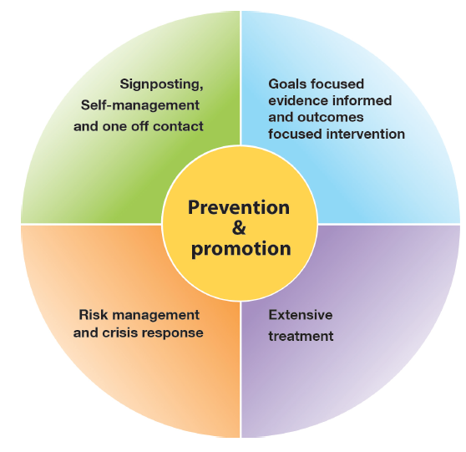
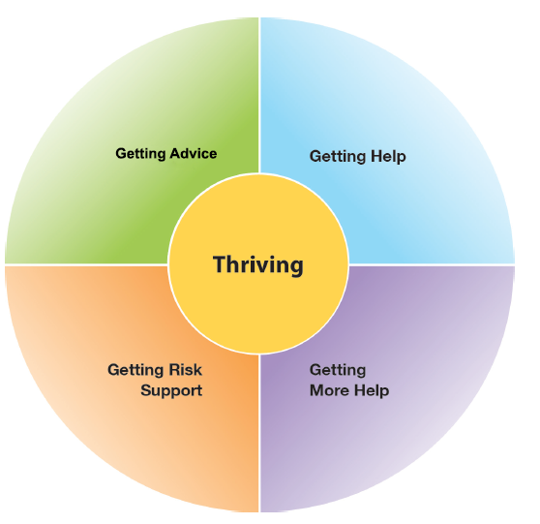
The THRIVE Conceptual Framework
Input offered
Description of the THRIVE-groups
Distinction between advice/support and evidence based “treatment”
The five needs based groups are distinct in terms of the:
needs and/or choices of the individuals within each group
skill mix of professionals required to meet these needs
resources required to meet the needs and/or choices of people in that group
THRIVE Elaborated, Second Edition (Wolpert et al., 2016)
Notes:
Rachel

Slide 6
THRIVE Key Principles
Shared decision making at heart of choice
Acknowledgment of limitation of evidence-based interventions
Acknowledgment of limitations of resources
Distinction between getting help (“treatment”) and risk support
Greater emphasis on how to help young people and communities build on their own strengths
THRIVE Elaborated, Second Edition (Wolpert et al., 2016)
Notes:
Rachel

Slide 7
The THRIVE Conceptual Framework: Latest Iteration (November 2016)
THRIVE was originally authored by professionals involved in mental health support for children and young people, all of whom came from a health background.
THRIVE Elaborated (Second Edition) now has co-authors from the world of education and social care, and have drawn on views from head teacher panels, CCG leads and local authority directors.
Highlights four key ways in which the THRIVE framework is inherently multi-agency:
1. THRIVE endorses multi-agency definitions of mental health promoting practices
2. THRIVE encourages shared multi-agency responsibility for promoting “thriving”
3. THRIVE promotes multi-agency proactive “advice” and “help”
4. THRIVE supports multi-agency clarity on endings as well as beginnings
THRIVE Elaborated, Second Edition (Wolpert et al., 2016)
Notes:
Rachel

Slide 8
The response to the THRIVE Conceptual Framework
We really like the concept and principles of THRIVE and would like to use it to underpin our redesign of mental health services for children and young people in line with Future in Mind
BUT…
What do the principles look like in practice on the ground?
How do we make it work in our area?
Is there a blueprint for implementation?
How should we design services to reflect THRIVE principles?
Can we access support for implementation?
How do we implement the concepts?
Notes:
Rachel

Slide 9
i-THRIVE Programme
i-THRIVE is the implementation programme that supports sites to translate the THRIVE conceptual framework into a model of care that fits local context.
The i-THRIVE programme is a collaboration between the Anna Freud National Centre for Children and Families, the Tavistock and Portman NHS Foundation Trust, Dartmouth Institute for Health Policy and Clinical Practice, and UCLPartners.
Notes:
Rachel

Slide 10
Aligned to existing programmes
The i-THRIVE programme complements existing transformation and Quality Improvement programmes in the NHS
Builds on local strengths across whole system

Slide 11
i-THRIVE Programme: offer to sites
Evaluation
Two year evaluation of i-THRIVE for accelerator sites
i-THRIVE Academy
Learning and development support for leaders and training modules for sites
Funded projects
Individual projects to create and test shared decision making aids in Camden and to implement THRIVE in NELFT
i-THRIVE Toolkit
Evidence based tools to aid implementation
i-THRIVE Approach to Implementation
Four phase approach to implementation drawn from implementation science evidence base
i-THRIVE Community of Practice
Shared learning events and forum for sites to share experiences about implementing THRIVE
Direct support to sites
from the national programme team
THRIVE Illustrated
Series of case studies highlighting how sites have approached the implementation of THRIVE
Notes:
Emma

Slide 12
Core principles and components of the i-THRIVE model of care

Slide 13
i-THRIVE Approach to Implementation: whole system change
MACRO
Consideration of Population Health Improvement
How agencies work together and commission services for the population
MESO
Needs based groups of young people and the services/ teams that enable delivery of care according to those needs
MICRO
Ways of working with young people and their families, and how professionals can work best in a collaborative and integrated way
Notes:
Emma

Slide 14
i-THRIVE Approach to Implementation: whole system change
Notes:
Emma

Slide 15
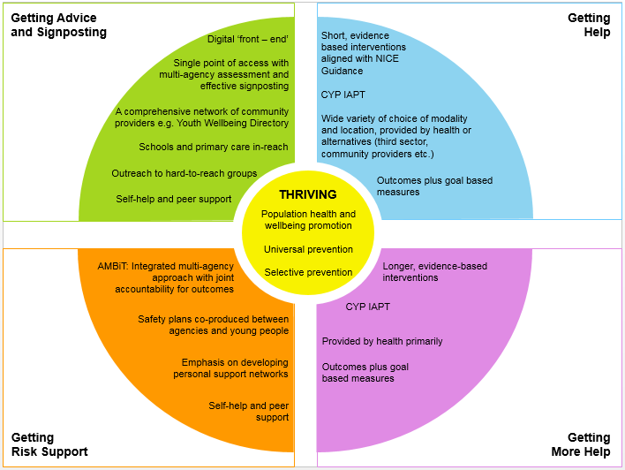
Core Components of an i-THRIVE Model of Care
Notes:
Emma

Slide 16
i-THRIVE Approach to Implementation Phase 1: Understanding Your System

Slide 17
i-THRIVE Approach to Implementation: process of implementation
Set up and governance
Engagement
Understanding your system
Prioritisation
Re-design
Implementation Planning
Structural features of Implementation
Developing Implementation teams
Workforce planning
Community of Practice
Training Clinical and Professional teams
Measurement in place
Phase 1
Phase 2
Engagement, understanding your system, and planning
Building capacity within your system
Learning from
Experience
Sustainability
Normalisation
Process Theory
Ongoing Implementation
Support Strategies
Making changes – use of Quality Improvement
Technical Assistance /Coaching/Supervision in Change Management
Supportive Feedback Mechanisms
Phase 4
Phase 3
Learning, embedding and sustaining
Implementation

Slide 18
Phase 1: Understanding Your System and Agreeing Your Priorities
1. Establishing a team who will oversee this process
Senior oversight, includes commissioners and providers of health, care and education.
2. Initial engagement with the system
Communication and engagement across the system, from senior leadership to team leads and those working with children and young people day to day.
Aim for agreement from the system, to increase awareness of issues as well as understanding of the possible approaches to improvement.
3. Analysis of your existing systems
Pathway Mapping
Data Analysis
Qualitative Understanding
4. THRIVE Baseline: How THRIVE-like are we currently?
5. Agreeing priorities for improvement
What are our collective aims?
What are the priority areas that will help us improve on these areas?
6. Transformation Design and Implementation Planning
Notes:
Not going to go through this much now, but will be sending the slides through after today

Slide 19
Detail of Delivery of Phase 1
Set up and communication across the whole system
Series of three workshops
Pathway Mapping and Analysis
Understanding system together, THRIVE Assessment and Prioritisation
Re-design
Data gathering
Quantitative: how is the system performing?
Qualitative: what are the perceived strengths and weaknesses? (staff & CYP)
Pathway structures
Workforce Analysis
Outputs
Phase 1 analysis report and Implementation plan

Slide 20
i-THRIVE Approach to Implementation Phase 1: Understanding Your System Establishing Priorities
Notes:
Today we will do this as an exercise
When you go back and do it with your wider groups of stakeholders in your locality these you will be able to undertake these steps with them
If you need any further information before you carry out the exercise with different teams you can contact us and we’ll be happy to support

Slide 21
Establishing Priorities
Based on our work mapping the pathways in [enter place name] and the results of the THRIVE Assessment Tool we will now begin to identify key priorities to focus on moving forward.
Session today:
Review of the top line priorities based on the THRIVE Assessment Tool exercise from [enter date] workshop
Discuss potential priorities now that we have had time to further think about our system
In groups identify your five top priorities and rank them in order
Share with the group as a whole and agree consensus on top five priorities to take forward

Slide 22
Establishing Priorities
THRIVE is made up of a set of core principles that relate to these three parts of the system: the macro, meso and micro system.
The THRIVE Assessment Tool explains each of these principles and provides four descriptions for each principle, which range from a very THRIVE-like system, to one that has some way to go before it can describe itself as ‘THRIVE-like’.
You have already scored each of the THRIVE principles based on your understanding of the current system in [enter place name].
Group Exercise
On each table are the individual THRIVE principles that you have already assessed as part of the THRIVE Assessment Tool.
As a group, decide on your top five priorities for [enter place name].
Think about your pathway maps, your understanding of the data and the scores of the THRIVE Assessment Tool as you rank the THRIVE principles in order of priority.
Agree a consensus on priorities 1, 2, 3 ,4 and 5.

Slide 23
Establishing Priorities
Group Exercise – Feedback
Now that you have identified your top five priorities on your tables, share these with the whole group.
Each table will take their turn in sharing their top five with the whole group.
Group Exercise – Agreeing Consensus
As a whole group you can now see what the top five priorities are for each table.
Agree a consensus as a whole group and identify the top five priorities for [enter name place] that you will address going forward.
Write these top five priorities on flip chart paper and make sure that they are visible to everyone in the room.

Slide 24
i-THRIVE Approach to Implementation Phase 1: Understanding Your System Gap Analysis
Notes:
Today we will do this as an exercise
When you go back and do it with your wider groups of stakeholders in your locality these you will be able to undertake these steps with them
If you need any further information before you carry out the exercise with different teams you can contact us and we’ll be happy to support

Slide 25
Gap Analysis
Now that we have identified our five key priorities it is helpful to look at those priorities individually and establish:
The ‘ideal’ as set out in the THRIVE principle
What is currently in place?
What is in development?
Identified gaps
What training might be useful?
Recommendations about transformation

Slide 26
Gap Analysis: group exercise
One hour
On your tables begin to complete the i-THRIVE Gap Analysis exercise
For priority one, write the agreed priority in the left hand column
Work your way through each column and add the requested information
This is in draft form so don’t worry about having the perfect wording – you will be able to tweak and refine this at a later date
Repeat with priorities two, three, four and five
Spend roughly 20 minutes on each priority

Slide 27
Gap Analysis: group exercise
30 mins
Share any key pieces of information that you have identified in using the i-THRIVE Gap Analysis exercise
What are the major gaps that you have identified?
Are there any quick wins that you think could lead to immediate progress?
Do you agree on the training that might be needed to support the workforce in moving towards the ideal of the THRIVE principle?
Have you got any great recommendations for transformation?
Capture any feedback on flipchart paper.

Slide 28
Next Steps

Slide 29
Next steps
Use the priorities and gap analysis work to develop a plan for service redesign
Discussion on plans for wider engagement and sharing of future steps
Redesign workshop

Slide 30
For more information: i-THRIVE
www.implementingthrive.org
Twitter @iTHRIVEinfo

Slide 31
For more information: the i-THRIVE Programme Team
Anna Moore:
i-THRIVE Lead
a.moore@ucl.ac.uk
Rachel James:
i-THRIVE Clinical Lead
rjames@tavi-port.nhs.uk
Bethan Morris:
i-THRIVE Research Officer
Bethan.morris@annafreud.org

