Slide 1
i-THRIVE in [place name]
“If we keep on doing what we have been doing, we are going to keep on getting what we have been getting”

Slide 2
Current climate in [place name] Name, Title Name, Title

Slide 3
Introduction to the THRIVE conceptual framework
Notes:
Rachel

Slide 4
The THRIVE Conceptual Framework
The THRIVE conceptual framework (Wolpert, et al. 2016) was developed as a collaboration between the Anna Freud National Centre for Children and Families and the Tavistock and Portman NHS Foundation Trust.
Built on learning from:
Child Outcomes Research Consortium (CORC); use of patient reported outcome measures to transform practice: www.corc.uk.net
Choice and Partnership Approach (CAPA); how to manage flow and embed shared decision making: http://capa.co.uk/
Payment Systems in CAMHS development; 19 case mix adjusted groupings: http://pbrcamhs.org/final-report-published/
Notes:
Rachel

Slide 5
The THRIVE Conceptual Framework: Latest Iteration (November 2016)
THRIVE was originally authored by professionals involved in mental health support for children and young people, all of whom came from a health background.
THRIVE Elaborated (Second Edition) now has co-authors from the world of education and social care, and have drawn on views from head teacher panels, CCG leads and local authority directors.
Highlights four key ways in which the THRIVE framework is inherently multi-agency:
1. THRIVE endorses multi-agency definitions of mental health promoting practices
2. THRIVE encourages shared multi-agency responsibility for promoting “thriving”
3. THRIVE promotes multi-agency proactive “advice” and “help”
4. THRIVE supports multi-agency clarity on endings as well as beginnings
THRIVE Elaborated, Second Edition (Wolpert et al., 2016)
Notes:
Rachel

Slide 6
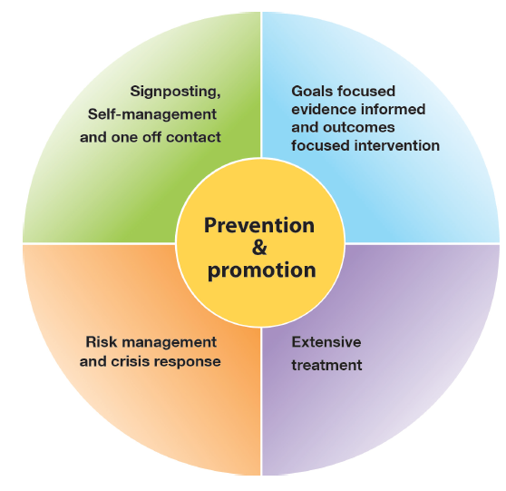
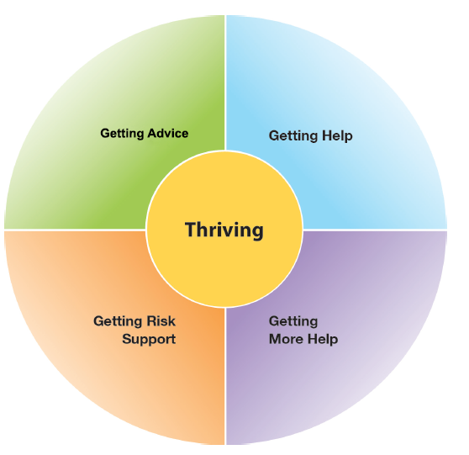
The THRIVE Conceptual Framework
Input offered
Description of the THRIVE-groups
Distinction between advice/support and evidence based “treatment”
The five needs based groups are distinct in terms of the:
needs and/or choices of the individuals within each group
skill mix of professionals required to meet these needs
resources required to meet the needs and/or choices of people in that group
THRIVE Elaborated, Second Edition (Wolpert et al., 2016)
Notes:
Rachel

Slide 7
THRIVE Key Principles
Shared decision making at heart of choice
Acknowledgment of limitation of evidence-based interventions
Acknowledgment of limitations of resources
Distinction between getting help (“treatment”) and risk support
Greater emphasis on how to help young people and communities build on their own strengths
THRIVE Elaborated, Second Edition (Wolpert et al., 2016)
Notes:
Rachel

Slide 8
Thriving: The Theory
Context: All children, young people and their families not currently needing individualised mental health advice or help are considered to be thriving. THRIVE would suggest that this group receive community initiatives that support mental wellness, emotional wellbeing and resilience of the whole population.
Data: It is anticipated that around 80-90% of the total population of children and young people will fall into the needs-based grouping of thriving.
Resource: No economic evaluations can robustly guide policy. Reports from current practice suggest that in many areas around 10-15% of the budget in children and young people’s metal health services is allocated to support community resilience programmes; consultation with teachers, health visitors and others; and other forms of intervention to support widespread wellbeing and mental health.
Provision: The THRIVE framework expects that the system actively applies research evidence of the kind of interventions that are likely to reduce the risk of developing mental health difficulties and promote wellbeing and mental health:
Universal prevention: Targeting the general public or a population group that has not been identified on basis of individual risk
Selective prevention: Targeting individuals or population subgroups who have risk factors placing them at a higher than average risk of developing mental health needs
Notes:
Rachel

Slide 9
Thriving: In Practice
Linking with public health, local communities and a wide range of agencies required to promote wellbeing
Consideration required in relation to how information will be disseminated through schools, online, youth programmes, children’s centres etc
Potential opportunity to incorporate Thriving into existing universal assessment and intervention mechanisms such as ‘redbooks’
Universal materials to support Thriving which can be disseminated across the system
Targeted interventions for groups of children and young people that we know are more likely to need support with their mental health
Notes:
Rachel

Slide 10
Getting Advice and Signposting: The Theory
Context: The children, young people and families who may require temporary support within the community or advice to self-manage long-term conditions for those who choose to do so.
Data: The modal number of sessions of children, young people and families in CAMHS is one. Practitioner reports suggest that some find just a single contact with services enough to normalize behavior and provide them with reassurance they are doing the right things to resolve the problem.
Resource: If it is estimated that 30% of children and young people needing specialist support would benefit from only small amount of resource, then this group would account for 8% of total spend and staff time.
Provision: The support provided in ‘getting advice’ can be provided in a range of settings including health, local authority, schools, social care and third sector. Input should involve some of the most experienced mental health workforce to determine how best to help. Local databases can help to identify relevant community and digital resources. Support should build on existing family resources and self-management promoted through information provision. THRIVE suggests an invitation to re-contact services after advice is given in case things do not improve could be made.
Notes:
Rachel

Slide 11
Getting Advice and Signposting: In Practice
Breaking down barriers and linking services to provide integrated care
Multi-agency assessments that are supported by senior mental health staff
Digital offer for information, support and guidance
Established community network of providers – choice of support for children, young people and their families
Mental health support accessible in schools and primary care
Early guidance to ensure the right treatment and the right time
Focus on early intervention to build resilience and influence outcomes positively
Notes:
Rachel

Slide 12
Getting Help: The Theory
Context: The children, young people and families who would benefit from focused, evidence-based treatment.
Data: Of the 60% of children, young people and their families who were assigned to ‘getting help’ only half were receiving care aligned to specific NICE guidance.
Resource: The mean number of face-to-face contacts was seven for this group.
Provision: The THRIVE model places a greater emphasis on ending interventions when they are not working. Input might draw on specialised technicians in different treatments. Treatment would involve explicit agreement from the beginning about the outcome being worked towards and the likely timeframe. There would be a plan for what happens if it is not achieved.
Notes:
Rachel

Slide 13
Getting More Help: The Theory
Context: The children, young people and families who would benefit from extensive long-term treatment. Some conditions such as psychosis, eating disorders and emerging personality disorders are likely to require this input.
Data: This group makes up 5% of children, young people and their families receiving input, but accounted for 39% of appointments. The average number of appointments attended is estimated to be around ten.
Resource: The range of costs within the group is likely to be very wide.
Provision: More procedurally defined interventions could be provided by less highly trained practitioners than are required for ‘getting advice’.
Notes:
Rachel

Slide 14
Getting Help and Getting More Help: In Practice
Establishing a common language
Importance of evidence based practice
Need for high quality outcomes which help to build an evidence base
The need for more defined interventions rather than open ended treatment
Clear goals identified at the beginning of treatment, and plan in place for what happens if those goals are not met
Better communication across physical health, social care and other agencies
Notes:
Rachel

Slide 15
Risk Support: The Theory
Context: These are the children, young people and families for who evidence-based treatment are not demonstrating changes in outcomes. There are often severe needs which can be long term and cross-generational. There can be limited resources (financial and human) and limited capacity to cope with family and life pressures and poor problem solving skills coupled with a lack of intra-familiar social support. There can be significant mental health issues, particularly substance misuse (alcohol), domestic violence and physical health problems.
Data: It is estimated that this group account for 5-10% of all young people currently accessing services, although it is currently hard to differentiate them from children, young people and families receiving interventions from ‘getting help’ and ‘getting more help’.
Resource: Practitioner reports suggest this group requires significant input, time and energy. Many may be being offered intensive treatments but not attending appointments and/or not making progress. They may routinely go into crisis or self-harm.
Provision: The THRIVE model suggests there needs to be close interagency collaboration and clarity on who is responsible.
Notes:
Rachel

Slide 16
Risk Support: In Practice
Whole system change required with buy in from key stakeholders
Would enable better support for staff with complex cases
Shared responsibility across agencies
Supporting cases that aren’t traditionally in each other’s territories
Facilitating conversation with children, young people and their families to help them identify their own needs
Early guidance to ensure right treatment and right time
Notes:
Rachel

Slide 17
FAQ: What’s the difference between Getting More Help and Getting Risk Support?
Getting help or more help
Getting risk support
evidence-based, carefully designed and tested for fidelity
aim of recovery, or goal of improvement expected to enhance wellbeing
participants committed to achieving change
focused activity with predetermined timeframes
structured with a theoretical rationale based on understanding of the disorder
modification to the treatment protocol is indicated by session by session treatment response
individually tailored support based on an explicit collaborative shared plan for each family
aim of reducing the risk of harm, catastrophic outcomes (death, injury) and decreasing the chance of deterioration as well as increasing self-management, resilience and agency
participants committed to improving their reactions to crises
ongoing process dependent on the young person’s needs
pragmatically driven; family to influence structure and content of the intervention within legal constraints
modification to the agreed protocol is a regular occurrence in response to the safety outcomes achieved
Notes:
Rachel

Slide 18
The THRIVE Conceptual Framework: Summary
The THRIVE framework:
replaces tiers with a whole system approach
is based on the identified needs of children, young people and their families
advocates the effective use of data to inform delivery and meet needs
identifies groups of children and young people and the sorts of support they need
draws a clearer distinction between “treatment” and support
builds on individual and community strengths wherever possible
ensures children, young people and their families are active decision makers
THRIVE Elaborated, Second Edition (Wolpert et al., 2016)
Notes:
Rachel

Slide 19
Q & A: your thoughts on the THRIVE conceptual framework [place name’s team]

Slide 20
Core components of i-THRIVE model

Slide 21
The response to the THRIVE Conceptual Framework
We really like the concept and principles of THRIVE and would like to use it to underpin our redesign of mental health services for children and young people in line with Future in Mind
BUT…
What do the principles look like in practice on the ground?
How do we make it work in our area?
Is there a blueprint for implementation?
How should we design services to reflect THRIVE principles?
Can we access support for implementation?
How do we implement the concepts?
Notes:
Rachel

Slide 22
i-THRIVE Programme
i-THRIVE is the implementation programme that supports sites to translate the THRIVE conceptual framework into a model of care that fits local context.
The i-THRIVE programme is a collaboration between the Anna Freud National Centre for Children and Families, the Tavistock and Portman NHS Foundation Trust, Dartmouth Institute for Health Policy and Clinical Practice, and UCLPartners.
Notes:
Rachel

Slide 23
i-THRIVE is a ‘Whole-Systems Approach’
Delivering good quality care that is efficient cannot be achieved successfully by looking at a single service or set of professionals, rather it needs to consider all the parts of the system.
This involves not only thinking about all the agencies that are involved in providing services, but also considering how well the different ‘levels’ of the system are working together.
One way of thinking about these levels is to think about it in terms of three parts, all of which are dependent on each other and interact with each other.
These are the ‘Macro’, ‘Meso’ and ‘Micro’ systems.
THRIVE focuses on providing care according to the needs of young people, and helps services to provide that care according to those needs identified.
Given this, when developing a view of the system, it is necessary to understand which patient groups that are being considered at each level in the system, as well as the services that are providing care to that patient group at that level.

Slide 24
i-THRIVE Approach to Implementation: whole system change
MACRO
Consideration of Population Health Improvement
How agencies work together and commission services for the population
MESO
Needs based groups of young people and the services/ teams that enable delivery of care according to those needs
MICRO
Ways of working with young people and their families, and how professionals can work best in a collaborative and integrated way
Notes:
Emma

Slide 25
i-THRIVE Approach to Implementation: whole system change
Notes:
Emma

Slide 26
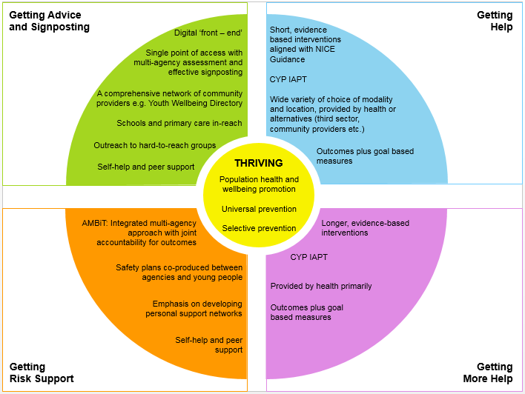
Core Components of an i-THRIVE Model of Care
Notes:
Emma

Slide 27
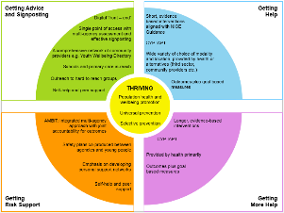
Components of an i-THRIVE Model of Care: Shared Decision Making
Shared decision making at each point in pathway
+
i-THRIVE Grids
Project funded by the Health Foundation to adapt Dartmouth Option Grid decision aid into a new grid for CAMHS settings
Six grids created after significant engagement with young people, parents, clinicians and other partners and piloted in Camden from February – August 2017
CollaboRATE measure used to collect baseline data and to measure change as a result of introduction of i-THRIVE Grids along with qualitative feedback from young people, parents and clinicians
Notes:
Emma

Slide 28
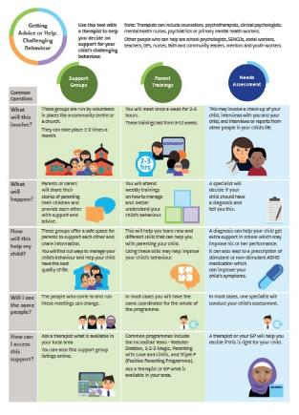
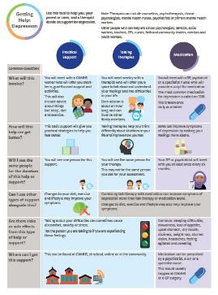
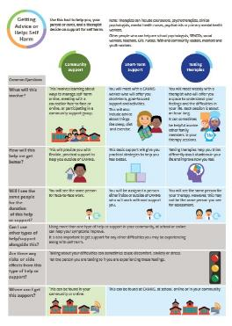
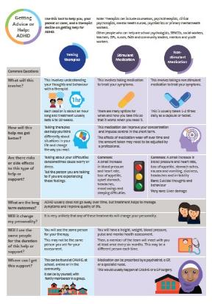
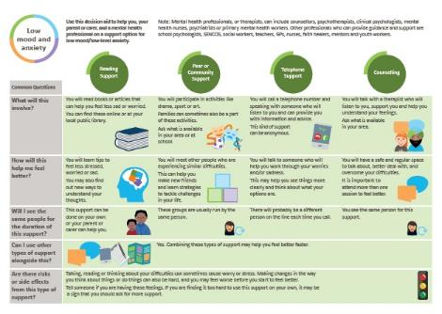
Components of an i-THRIVE Model of Care: Shared Decision Making
Notes:
Emma

Slide 29
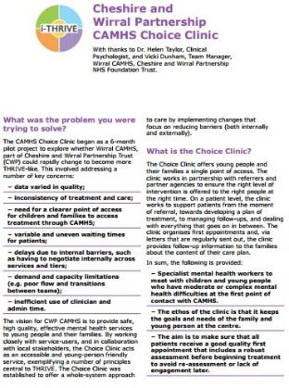
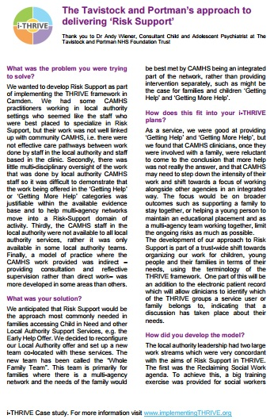
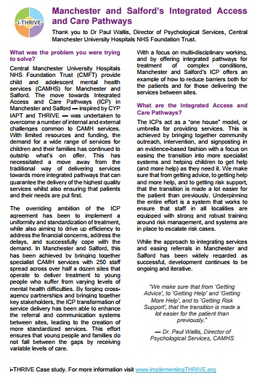
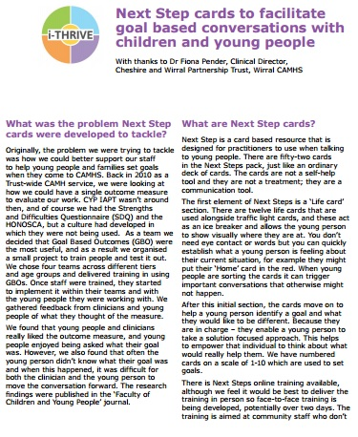
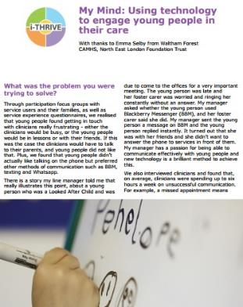
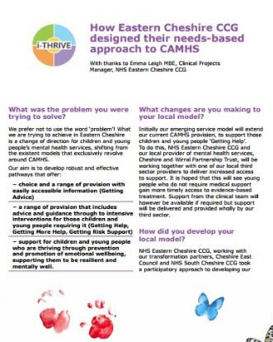
THRIVE Illustrated: Case Studies
Notes:
Emma

Slide 30
Key learning from i-THRIVE Accelerator Sites
Digital front end for ‘Thriving’ and ‘Getting Advice and Signposting’ websites from Cambridgeshire and Peterborough and Bexley and the MyMind app from Waltham Forest
Multi-agency approach to ‘Getting Risk Support’ co located CAMHS services in Camden and CAMHS supervision to system wide professionals
Workforce development across the system ‘Wellbeing Leads’ in Cambridgeshire and Peterborough and ‘THRIVE Practitioners’ in Manchester and Salford
Shared Decision Making trialing of i-THRIVE Grids in Camden
Embedding THRIVE terminology within Carenotes in Camden and the Current View Tool in Tower Hamlets
‘Getting Advice and Signposting’ service in Tower Hamlets that delivers signposting, consultation to the extended network and brief psychoeducation, assessment, intervention and advice on self-management
Multi-disciplinary assessment in Hertfordshire provided by mental health workers placed into multi-disciplinary early help teams
Integrated pathways in Manchester and Salford
CAMHS in reach to the wider system in Stockport to multi-agency Safeguarding Hub, Local Integrated Children’s Service, schools and care leavers team
Notes:
Rachel/Emma

Slide 31
Support available to i-THRIVE sites

Slide 32
i-THRIVE Programme: offer to sites
Evaluation
Two year evaluation of i-THRIVE for accelerator sites
i-THRIVE Academy
Learning and development support for leaders and training modules for sites
Funded projects
Individual projects to create and test shared decision making aids in Camden and to implement THRIVE in NELFT
i-THRIVE Toolkit
Evidence based tools to aid implementation
i-THRIVE Approach to Implementation
Four phase approach to implementation drawn from implementation science evidence base
i-THRIVE Community of Practice
Shared learning events and forum for sites to share experiences about implementing THRIVE
Direct support to sites
from the national programme team
THRIVE Illustrated
Series of case studies highlighting how sites have approached the implementation of THRIVE
Notes:
Emma

Slide 33
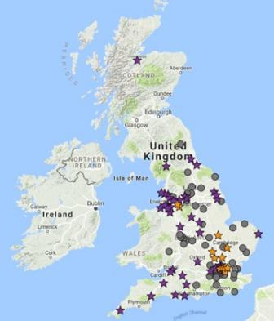
Learning from the i-THRIVE Community of Practice
10
national accelerator sites in October 2015
48%
of children and young people within England
74
CCG areas by February 2018
288 individuals in the Community of Practice
22% health commissioner
52% health provider
9% local authority
3% voluntary sector
3% education
11% other
7
shared learning events held
attended by over
280
Notes:
Emma

Slide 34
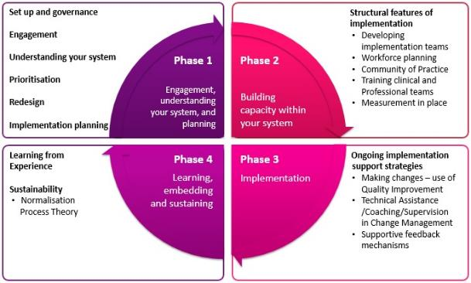
i-THRIVE Approach to Implementation
Notes:
Emma

Slide 35
Support for implementation sites
A range of tools to support an evidence based approach to implementation in line with the i-THRIVE approach.
Available at www.implementingTHRIVE.org
Pathway mapping
Quantitative data
Qualitative data
THRIVE Assessment Tool
Gap analysis
Prioritising areas for improvement
Redesign
Implementation planning
Notes:
Emma

Slide 36
i-THRIVE Academy
Pilots in March and April 2017: Four learning and development modules created based on key competencies required to deliver care in a THRIVE-like way
214
Professionals from across the system of support for children and young people’s mental health
66% health
18% local authority
4% education
6% third sector
6% other
56
from
organisations
30
covering
CCG areas
16.3%
Shared decision making
that are responsible for
Risk support
of children and young people in England
Getting advice: assessment and signposting
When to stop treatment
Notes:
Emma

Slide 37
Q & A: your thoughts on the i-THRIVE programme [place name’s team]

Slide 38
Reviewing the current system in [place name]

Slide 39
Reviewing the Current System in [place name]
i-THRIVE is a model of care that is translated to suit local systems and context
As a starting point, it is often helpful to take stock of how the local system currently delivers support to children, young people and their families
Some things that you deliver will already fit with the i-THRIVE model
We would like you to discuss in your tables what [place name] currently does well in relation to the i-THRIVE component model and what the key areas for improvement are
This will help you to think about priorities moving forward
EXERCISE:
What is currently delivered well in [place name]?
What are the current areas for improvement?
45 mins to complete task
30 mins of feeding back to the room

Slide 40
Reviewing the Current System in [place name]
Notes:
THRIVE identifies the needs based groupings
i-THRIVE has identified categories of services that when grouped together enable to to deliver needs based care
These services are what should be in place to deliver needs based care – how they are then delivered is based on local context
The bullet points on the right are integral to the i-THRIVE model and need to be embedded to all services for all groups

Slide 41
Reviewing the Current System in [place name]
EXERCISE:
What is currently delivered well in [place name]?
What are the current areas for improvement?
45 mins to complete task
30 mins of feeding back to the room
FEEDBACK from each table:
One success to celebrate
One priority for improvement

Slide 42
Successes to Celebrate
[add these in as they are fed back]

Slide 43
Priorities for Improvement
[add these in as they are fed back]

Slide 44
Taking i-THRIVE Forward in [place name] [place name’s team]

Slide 45
Taking i-THRIVE forward in [place name]
Deciding on a vision for i-THRIVE in [place name]
What do we want to prioritise?
Sharing the i-THRIVE model with the whole system; who do we need to engage with?
How do we include children and young people in the development of i-THRIVE in [place name]?
Payment by results pilot (if applicable)

Slide 46
Next Steps

Slide 47
Next Steps
Slides from today to be shared
Interested in being part of implementation?
Further questions? Contact [name] at [email@address]

Slide 48
For more information: i-THRIVE
www.implementingthrive.org
Twitter @iTHRIVEinfo

Slide 49
For more information: the i-THRIVE Programme Team
Anna Moore:
i-THRIVE Lead
a.moore@ucl.ac.uk
Rachel James:
i-THRIVE Clinical Lead
rjames@tavi-port.nhs.uk
Bethan Morris:
i-THRIVE Research Officer
Bethan.morris@annafreud.org

