Slide 1
Implementing THRIVE Phase 1: Developing a full understanding of your current system
“If we keep on doing what we have been doing, we are going to keep on getting what we have been getting”

Slide 2
Our Presentation Today
Overview of THRIVE and i-THRIVE
Review of pathway
Review of data collected in relation to the pathway
Top level actions to take forward

Slide 3
Overview of THRIVE and i-THRIVE

Slide 4
The THRIVE Conceptual Framework
The THRIVE conceptual framework (Wolpert, et al. 2016) was developed as a collaboration between the Anna Freud National Centre for Children and Families and the Tavistock and Portman NHS Foundation Trust.
Built on learning from:
Child Outcomes Research Consortium (CORC); use of patient reported outcome measures to transform practice: www.corc.uk.net
Choice and Partnership Approach (CAPA); how to manage flow and embed shared decision making: http://capa.co.uk/
Payment Systems in CAMHS development; 19 case mix adjusted groupings: http://pbrcamhs.org/final-report-published/
Notes:
Rachel

Slide 5
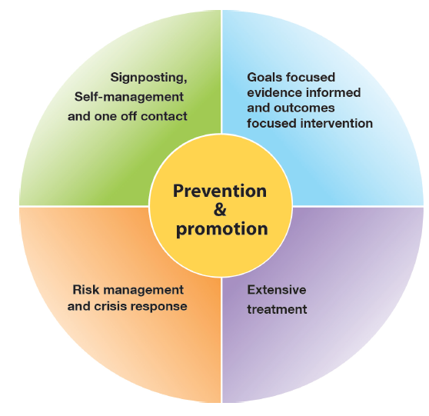
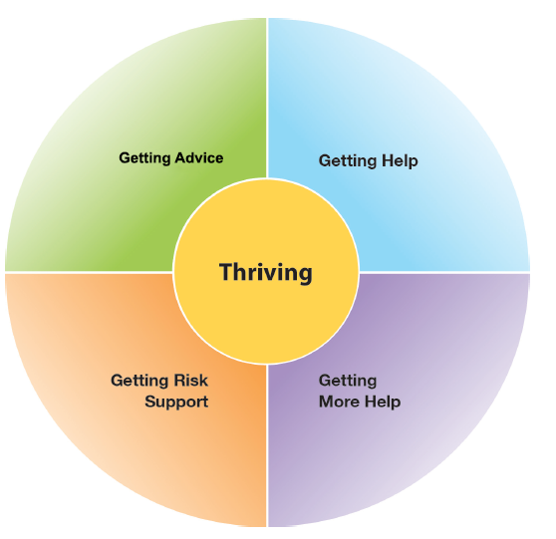
The THRIVE Conceptual Framework
Input offered
Description of the THRIVE-groups
Distinction between advice/support and evidence based “treatment”
The five needs based groups are distinct in terms of the:
needs and/or choices of the individuals within each group
skill mix of professionals required to meet these needs
resources required to meet the needs and/or choices of people in that group
THRIVE Elaborated, Second Edition (Wolpert et al., 2016)
Notes:
Rachel

Slide 6
THRIVE Key Principles
Shared decision making at heart of choice
Acknowledgment of limitation of evidence-based interventions
Acknowledgment of limitations of resources
Distinction between getting help (“treatment”) and risk support
Greater emphasis on how to help young people and communities build on their own strengths
THRIVE Elaborated, Second Edition (Wolpert et al., 2016)
Notes:
Rachel

Slide 7
The THRIVE Conceptual Framework: Latest Iteration (November 2016)
THRIVE was originally authored by professionals involved in mental health support for children and young people, all of whom came from a health background.
THRIVE Elaborated (Second Edition) now has co-authors from the world of education and social care, and have drawn on views from head teacher panels, CCG leads and local authority directors.
Highlights four key ways in which the THRIVE framework is inherently multi-agency:
1. THRIVE endorses multi-agency definitions of mental health promoting practices
2. THRIVE encourages shared multi-agency responsibility for promoting “thriving”
3. THRIVE promotes multi-agency proactive “advice” and “help”
4. THRIVE supports multi-agency clarity on endings as well as beginnings
THRIVE Elaborated, Second Edition (Wolpert et al., 2016)
Notes:
Rachel

Slide 8
The response to the THRIVE Conceptual Framework
We really like the concept and principles of THRIVE and would like to use it to underpin our redesign of mental health services for children and young people in line with Future in Mind
BUT…
What do the principles look like in practice on the ground?
How do we make it work in our area?
Is there a blueprint for implementation?
How should we design services to reflect THRIVE principles?
Can we access support for implementation?
How do we implement the concepts?
Notes:
Rachel

Slide 9
i-THRIVE Programme
i-THRIVE is the implementation programme that supports sites to translate the THRIVE conceptual framework into a model of care that fits local context.
The i-THRIVE programme is a collaboration between the Anna Freud National Centre for Children and Families, the Tavistock and Portman NHS Foundation Trust, Dartmouth Institute for Health Policy and Clinical Practice, and UCLPartners.
Notes:
Rachel

Slide 10
Aligned to existing programmes
The i-THRIVE programme complements existing transformation and Quality Improvement programmes in the NHS
Builds on local strengths across whole system

Slide 11
i-THRIVE Programme: offer to sites
Evaluation
Two year evaluation of i-THRIVE for accelerator sites
i-THRIVE Academy
Learning and development support for leaders and training modules for sites
Funded projects
Individual projects to create and test shared decision making aids in Camden and to implement THRIVE in NELFT
i-THRIVE Toolkit
Evidence based tools to aid implementation
i-THRIVE Approach to Implementation
Four phase approach to implementation drawn from implementation science evidence base
i-THRIVE Community of Practice
Shared learning events and forum for sites to share experiences about implementing THRIVE
Direct support to sites
from the national programme team
THRIVE Illustrated
Series of case studies highlighting how sites have approached the implementation of THRIVE
Notes:
Emma

Slide 12
Core principles and components of the i-THRIVE model of care

Slide 13
i-THRIVE Approach to Implementation: whole system change
MACRO
Consideration of Population Health Improvement
How agencies work together and commission services for the population
MESO
Needs based groups of young people and the services/ teams that enable delivery of care according to those needs
MICRO
Ways of working with young people and their families, and how professionals can work best in a collaborative and integrated way
Notes:
Emma

Slide 14
i-THRIVE Approach to Implementation: whole system change
Notes:
Emma

Slide 15
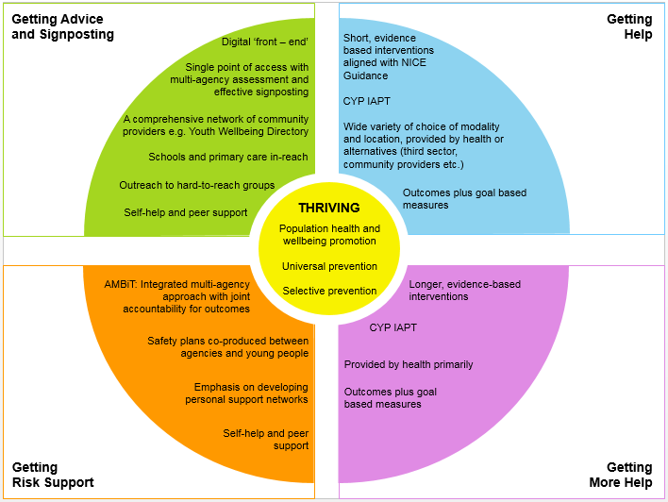
Core Components of an i-THRIVE Model of Care
Notes:
Emma

Slide 16
i-THRIVE Approach to Implementation Phase 1: Understanding Your System

Slide 17
i-THRIVE Approach to Implementation: process of implementation
Set up and governance
Engagement
Understanding your system
Prioritisation
Re-design
Implementation Planning
Structural features of Implementation
Developing Implementation teams
Workforce planning
Community of Practice
Training Clinical and Professional teams
Measurement in place
Phase 1
Phase 2
Engagement, understanding your system, and planning
Building capacity within your system
Learning from
Experience
Sustainability
Normalisation
Process Theory
Ongoing Implementation
Support Strategies
Making changes – use of Quality Improvement
Technical Assistance /Coaching/Supervision in Change Management
Supportive Feedback Mechanisms
Phase 4
Phase 3
Learning, embedding and sustaining
Implementation

Slide 18
Phase 1: Understanding Your System and Agreeing Your Priorities
1. Establishing a team who will oversee this process
Senior oversight, includes commissioners and providers of health, care and education.
2. Initial engagement with the system
Communication and engagement across the system, from senior leadership to team leads and those working with children and young people day to day.
Aim for agreement from the system, to increase awareness of issues as well as understanding of the possible approaches to improvement.
3. Analysis of your existing systems
Pathway Mapping
Data Analysis
Qualitative Understanding
4. THRIVE Baseline: How THRIVE-like are we currently?
5. Agreeing priorities for improvement
What are our collective aims?
What are the priority areas that will help us improve on these areas?
6. Transformation Design and Implementation Planning

Slide 19
Aim for today
THRIVE is a whole system, integrated approach to care that aims to integrate health, social care and education systems, and to understand how independent and third sector organisations play a part in caring for young people.
Aim for today is to review with you the data collected and discuss priorities for improving your pathway.
To help you do this we will consider:
The pathway map created at the last workshop
The data collected and what it tells us

Slide 20
Mapping Your Pathways: work completed
At the last workshop we:
Defined the scope of our pathway
Built our pathway
Reviewed the pathway as a group
Analysed the pathway from four different perspectives:
Patient experience
Operations (interactions between services and agencies)
Evidenced based interventions
Outcomes and measures
Highlighted areas of good practice, problems with quality and problems with duplication and inefficiency
Reviewed the pathway as a group again
Added in additional agencies that had previously been missed
Identified areas that needed further work or a ‘deep dive’

Slide 21
Mapped Pathway
[enter picture of mapped pathway]

Slide 22
i-THRIVE Approach to Implementation Phase 1: Understanding Your System Data Analysis

Slide 23
Data Analysis
Developing a map of your existing pathways is an important first step to understanding how your system is working currently
A critical second step is to understand how this is functioning:
How does this pathway impact on patient outcomes?
Does the structure of the pathway enable us to meet basic standards around access and waiting times?
Is it an efficient system?
Does the way the pathway functions put pressure on any particular parts of the system, e.g. primary care or education?
What do children, young people and parents think of the way the system currently works?
Are there any parts of the pathway have unintended consequences, such as children and young people receiving poor care?

Slide 24
Data and Discussion
Over the next few slides we will present some graphs which help show how children and young people are moving though your pathways
This information has been collected by [enter name] and relates to [enter services names]
This data relates to all children and young people receiving support during [enter time period]
[enter any further statements about the data]

Slide 25
System Data Analysis: Quantitative
[enter overview of quantitative data from review of the system]

Slide 26
System Data Analysis: Quantitative
[enter overview of quantitative data from review of the system]

Slide 27
System Data Analysis: Quantitative
[enter overview of quantitative data from review of the system]

Slide 28
System Data Analysis: Quantitative
[enter overview of quantitative data from review of the system]

Slide 29
System Data Analysis: Quantitative
[enter overview of quantitative data from review of the system]

Slide 30
System Data Analysis: Quantitative
[enter overview of quantitative data from review of the system]

Slide 31
System Data Analysis: Quantitative
[enter overview of quantitative data from review of the system]

Slide 32
Data and Discussion: Groups
You will now review the data presented in smaller groups
45 minutes
As a group discuss the following points:
Does the data presented reflect your personal experiences of the local system?
Are there any surprises in the data presented?
Is there anything that needs further contextual investigation?
Is the data for your local system in line with national benchmarking?
What data is missing?
Feedback: 30 minutes
Each table feeds back their key points to the group as a whole
Comments on the points shared by each table

Slide 33
Data and Discussion: actions to take forward
Based on the group discussions and the feedback we will now identify any further investigation that needs to be undertaken
What do we need to look into further?
What additional data do we need to collect?
Do we have data from all agencies involved in supporting children and young people?
15 minutes
List all actions to take forward on flipchart paper

Slide 34
Next Steps

Slide 35
Next steps
Action points typed up and sent out to the group
Qualitative review of the system undertaken
Plans for further work on understanding the system including the THRIVE Assessment Tool and agreeing priorities to take forward
Redesign workshop

Slide 36
For more information: the i-THRIVE Programme Team
Anna Moore:
i-THRIVE Lead
a.moore@ucl.ac.uk
Rachel James:
i-THRIVE Clinical Lead
rjames@tavi-port.nhs.uk
Bethan Morris:
i-THRIVE Research Officer
Bethan.morris@annafreud.org

