Slide 1
Implementing THRIVE Phase 1: Developing a full understanding of your current system
“If we keep on doing what we have been doing, we are going to keep on getting what we have been getting”

Slide 2
Our Presentation Today
Overview of THRIVE and i-THRIVE
Review of pathway
Review of data collected in relation to the pathway
Top level actions to take forward

Slide 3
Overview of THRIVE and i-THRIVE

Slide 4
THRIVE & i-THRIVE
The THRIVE conceptual framework was developed as a collaboration between the Anna Freud National Centre for Children and Families and the Tavistock and Portman NHS Foundation Trust.
i-THRIVE is the implementation programme that supports sites to translate the THRIVE conceptual framework into a model of care that fits local context.
The i-THRIVE programme is a collaboration between the Anna Freud National Centre for Children and Families, the Tavistock and Portman NHS Foundation Trust, Dartmouth Institute for Health Policy and Clinical Practice (US), and UCLPartners.

Slide 5
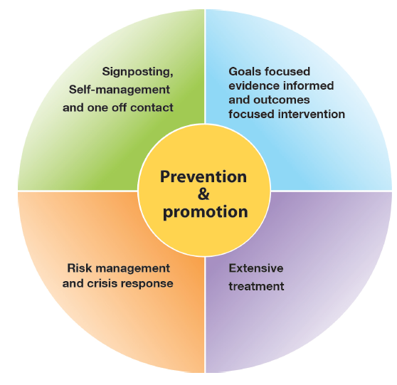
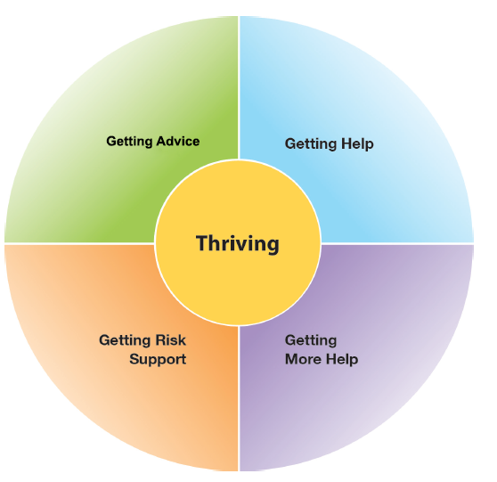
The THRIVE Conceptual Framework
Input offered
Description of the THRIVE-groups
Distinction between advice/support and evidence based ‘treatment’
Five Needs Based Groups are distinct in terms of the:
needs and/or choices of the individuals within each group
skill mix of professionals required to meet these needs
resources required to meet the needs and/or choices of people in that group

Slide 6
i-THRIVE Programme
The i-THRIVE programme was developed in response to the demand for support with implementation of the THRIVE conceptual framework
i-THRIVE supports sites to translate the THRIVE conceptual framework into a model of care that fits local context
The programme was created thanks to its recognition as an NHS Innovation Accelerator, led by Dr Anna Moore

Slide 7
Aligned to existing programmes
The i-THRIVE programme complements existing transformation and Quality Improvement programmes in the NHS
Builds on local strengths across whole system

Slide 8
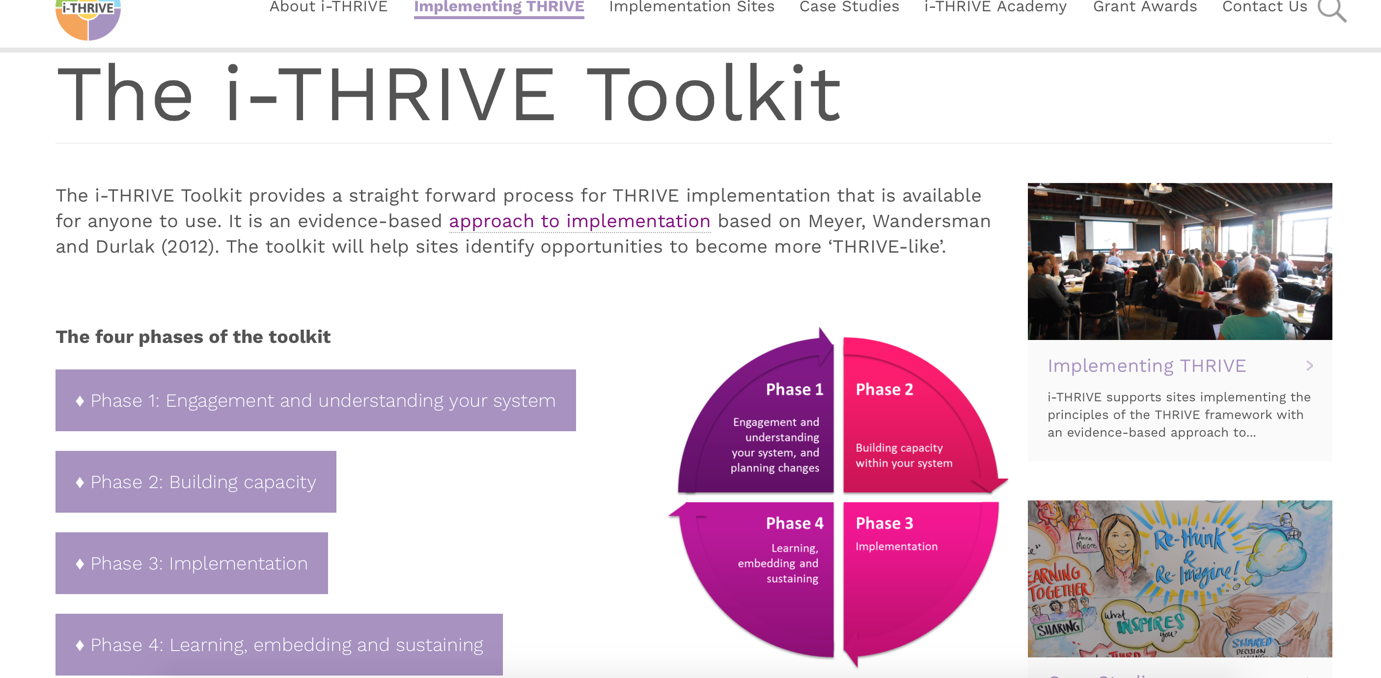
Support for sites implementing THRIVE
Website at www.implementingthrive.org
i-THRIVE Community of Practice member with access to shared learning events
i-THRIVE Academy; four training modules funded by Health Education England
i-THRIVE Illustrated; a series of case studies highlighting how different sites have approached the implementation of THRIVE
i-THRIVE Toolkit; a range of tools to support an evidence based approach to implementation

Slide 9
Core principles and components of the i-THRIVE model of care

Slide 10
i-THRIVE : possible components of an i-THRIVE Model of Care
Getting Advice and Signposting
Getting Help
Digital ‘front – end’
Short, evidence based interventions aligned with NICE Guidance
Single point of access with multi-agency assessment & effective signposting
Creating a comprehensive network of community providers: Youth Wellbeing Directory
CYP IAPT
Wide variety of choice of modality and location, provided by health or alternatives (3rd sector, community providers)
Outreach to Hard-to-reach groups
Schools and primary care in-reach
Self-help and peer-support
Outcomes plus goal based measures
AMBiT: Integrated multi-agency approach with joint accountability for outcomes
Longer, evidence based interventions
Safety plans co-produced between agencies & young people
CYP IAPT
Provided by health primarily
Emphasis on developing Personal support network
Outcomes plus goal based measures
Self-help and peer-support
Getting More Help
Risk Support
Notes:
One question often raised by sites looking at how to implement THRIVE was what would a THRIVE-like service or system look like in practice? The i-THRIVE programme suggests a set of components that as a whole would make up an i-THRIVE model of care; with specific requirements for the needs based groupings. For instance, there should be a digital front end to support children and young people looking for advice and signposting, while all evidence based interventions delivered as part of ‘getting help’ and ‘getting more help’ should be in line with CYPIAPT and have agreed goal based outcomes.

Slide 11
i-THRIVE Approach to Implementation Phase 1: Understanding Your System

Slide 12
i-THRIVE Approach to Implementation: process of implementation
Set up and governance
Engagement
Understanding your system
Prioritisation
Re-design
Implementation Planning
Structural features of Implementation
Developing Implementation teams
Workforce planning
Community of Practice
Training Clinical and Professional teams
Measurement in place
3-4 months
3-6 months
Phase 1
Phase 2
Engagement, understanding your system, and planning
Building capacity within your system
Learning from
Experience
Sustainability
Normalisation
Process Theory
Ongoing Implementation
Support Strategies
Making changes – use of Quality Improvement
Technical Assistance /Coaching/Supervision in Change Management
Supportive Feedback Mechanisms
Phase 4
Phase 3
Learning, embedding and sustaining
Implementation
2 months – on going
1 year cycles

Slide 13
Phase 1: Understanding Your System and Agreeing Your Priorities
1. Establishing a team who will oversee this process
Senior oversight, includes commissioners and providers of health, care and education.
2. Initial engagement with the system
Communication and engagement across the system, from senior leadership to team leads and those working with children and young people day to day.
Aim for agreement from the system, to increase awareness of issues as well as understanding of the possible approaches to improvement.
3. Analysis of your existing systems
Pathway Mapping
Data Analysis
Qualitative Understanding
4. THRIVE Baseline: How THRIVE-like are we currently?
5. Agreeing priorities for improvement
What are our collective aims?
What are the priority areas that will help us improve on these areas?
6. Transformation Design and Implementation Planning

Slide 14
Aim for today
THRIVE is a whole system, integrated approach to care that aims to integrate health, social care and education systems, and to understand how independent and third sector organisations play a part in caring for young people.
Aim for today is to review with you the data collected and discuss priorities for improving your pathway.
To help you do this we will consider:
The pathway map created at the last workshop
The data collected and what it tells us

Slide 15
Mapping Your Pathways: work completed
At the last workshop we:
Defined the scope of our pathway
Built our pathway
Reviewed the pathway as a group
Analysed the pathway from four different perspectives:
Patient experience
Operations (interactions between services and agencies)
Evidenced based interventions
Outcomes and measures
Highlighted areas of good practice, problems with quality and problems with duplication and inefficiency
Reviewed the pathway as a group again
Added in additional agencies that had previously been missed
Identified areas that needed further work or a ‘deep dive’

Slide 16
Mapped Pathway
[enter picture of mapped pathway]

Slide 17
i-THRIVE Approach to Implementation Phase 1: Understanding Your System Data Analysis

Slide 18
Data Analysis
Developing a map of your existing pathways is an important first step to understanding how your system is working currently
A critical second step is to understand how this is functioning:
How does this pathway impact on patient outcomes?
Does the structure of the pathway enable us to meet basic standards around access and waiting times?
Is it an efficient system?
Does the way the pathway functions put pressure on any particular parts of the system, e.g. primary care or education?
What do children, young people and parents think of the way the system currently works?
Are there any parts of the pathway have unintended consequences, such as children and young people receiving poor care?

Slide 19
Data and Discussion
Over the next few slides we will present some graphs which help show how children and young people are moving though your pathways
This information has been collected by [enter name] and relates to [enter services names]
This data relates to all children and young people receiving support during [enter time period]
[enter any further statements about the data]

Slide 20
System Data Analysis: Quantitative
[enter overview of quantitative data from review of the system]

Slide 21
System Data Analysis: Quantitative
[enter overview of quantitative data from review of the system]

Slide 22
System Data Analysis: Quantitative
[enter overview of quantitative data from review of the system]

Slide 23
System Data Analysis: Quantitative
[enter overview of quantitative data from review of the system]

Slide 24
System Data Analysis: Quantitative
[enter overview of quantitative data from review of the system]

Slide 25
System Data Analysis: Quantitative
[enter overview of quantitative data from review of the system]

Slide 26
System Data Analysis: Quantitative
[enter overview of quantitative data from review of the system]

Slide 27
Data and Discussion: Groups
You will now review the data presented in smaller groups
45 minutes
As a group discuss the following points:
Does the data presented reflect your personal experiences of the local system?
Are there any surprises in the data presented?
Is there anything that needs further contextual investigation?
Is the data for your local system in line with national benchmarking?
What data is missing?
Feedback: 30 minutes
Each table feeds back their key points to the group as a whole
Comments on the points shared by each table

Slide 28
Data and Discussion: actions to take forward
Based on the group discussions and the feedback we will now identify any further investigation that needs to be undertaken
What do we need to look into further?
What additional data do we need to collect?
Do we have data from all agencies involved in supporting children and young people?
15 minutes
List all actions to take forward on flipchart paper

Slide 29
Next Steps

Slide 30
Next steps
Action points typed up and sent out to the group
Qualitative review of the system undertaken
Plans for further work on understanding the system including the THRIVE Assessment Tool and agreeing priorities to take forward
Redesign workshop

Slide 31
For more information: the i-THRIVE Programme Team
Anna Moore:
i-THRIVE Lead
a.moore@ucl.ac.uk
Emma Louisy:
i-THRIVE Programme Manager
ELouisy@Tavi-Port.nhs.uk
Rachel James:
i-THRIVE Clinical Lead
rjames@tavi-port.nhs.uk
Ilse Lee:
Senior Research Assistant and Community of Practice Manager
Ilse.Lee@annafreud.org
Currently on Maternity Leave

