Slide 1
Implementing THRIVE Phase 1: Developing a full understanding of your current system
“If we keep on doing what we have been doing, we are going to keep on getting what we have been getting”

Slide 2
Our Presentation Today
Overview of THRIVE and i-THRIVE
Recap of work already undertaken
Thinking about Redesign
Top level actions to take forward

Slide 3
Overview of THRIVE and i-THRIVE

Slide 4
The THRIVE Conceptual Framework
The THRIVE conceptual framework (Wolpert, et al. 2016) was developed as a collaboration between the Anna Freud National Centre for Children and Families and the Tavistock and Portman NHS Foundation Trust.
Built on learning from:
Child Outcomes Research Consortium (CORC); use of patient reported outcome measures to transform practice: www.corc.uk.net
Choice and Partnership Approach (CAPA); how to manage flow and embed shared decision making: http://capa.co.uk/
Payment Systems in CAMHS development; 19 case mix adjusted groupings: http://pbrcamhs.org/final-report-published/
Notes:
Rachel

Slide 5
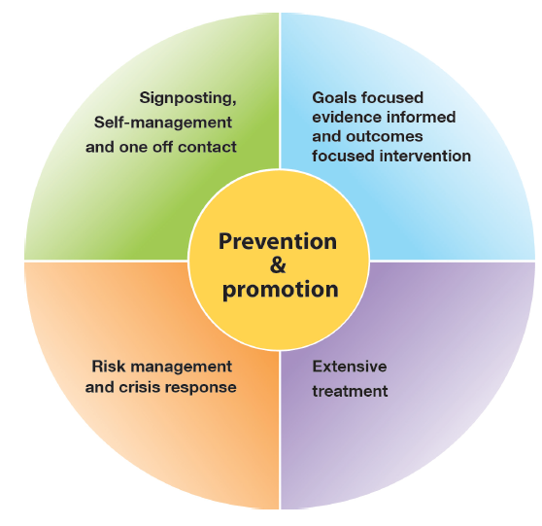
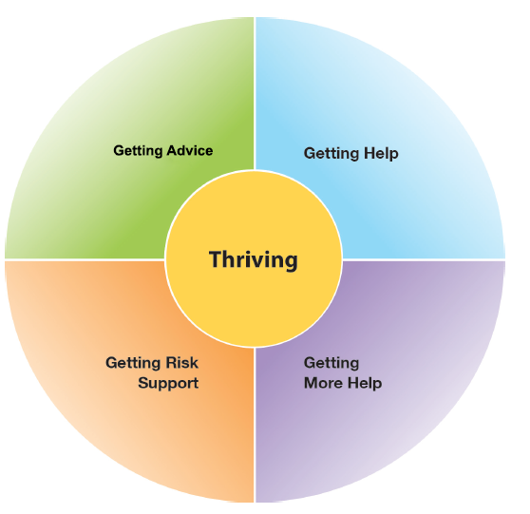
The THRIVE Conceptual Framework
Input offered
Description of the THRIVE-groups
Distinction between advice/support and evidence based “treatment”
The five needs based groups are distinct in terms of the:
needs and/or choices of the individuals within each group
skill mix of professionals required to meet these needs
resources required to meet the needs and/or choices of people in that group
THRIVE Elaborated, Second Edition (Wolpert et al., 2016)
Notes:
Rachel

Slide 6
THRIVE Key Principles
Shared decision making at heart of choice
Acknowledgment of limitation of evidence-based interventions
Acknowledgment of limitations of resources
Distinction between getting help (“treatment”) and risk support
Greater emphasis on how to help young people and communities build on their own strengths
THRIVE Elaborated, Second Edition (Wolpert et al., 2016)
Notes:
Rachel

Slide 7
The THRIVE Conceptual Framework: Latest Iteration (November 2016)
THRIVE was originally authored by professionals involved in mental health support for children and young people, all of whom came from a health background.
THRIVE Elaborated (Second Edition) now has co-authors from the world of education and social care, and have drawn on views from head teacher panels, CCG leads and local authority directors.
Highlights four key ways in which the THRIVE framework is inherently multi-agency:
1. THRIVE endorses multi-agency definitions of mental health promoting practices
2. THRIVE encourages shared multi-agency responsibility for promoting “thriving”
3. THRIVE promotes multi-agency proactive “advice” and “help”
4. THRIVE supports multi-agency clarity on endings as well as beginnings
THRIVE Elaborated, Second Edition (Wolpert et al., 2016)
Notes:
Rachel

Slide 8
The response to the THRIVE Conceptual Framework
We really like the concept and principles of THRIVE and would like to use it to underpin our redesign of mental health services for children and young people in line with Future in Mind
BUT…
What do the principles look like in practice on the ground?
How do we make it work in our area?
Is there a blueprint for implementation?
How should we design services to reflect THRIVE principles?
Can we access support for implementation?
How do we implement the concepts?
Notes:
Rachel

Slide 9
i-THRIVE Programme
i-THRIVE is the implementation programme that supports sites to translate the THRIVE conceptual framework into a model of care that fits local context.
The i-THRIVE programme is a collaboration between the Anna Freud National Centre for Children and Families, the Tavistock and Portman NHS Foundation Trust, Dartmouth Institute for Health Policy and Clinical Practice, and UCLPartners.
Notes:
Rachel

Slide 10
Aligned to existing programmes
The i-THRIVE programme complements existing transformation and Quality Improvement programmes in the NHS
Builds on local strengths across whole system

Slide 11
i-THRIVE Programme: offer to sites
Evaluation
Two year evaluation of i-THRIVE for accelerator sites
i-THRIVE Academy
Learning and development support for leaders and training modules for sites
Funded projects
Individual projects to create and test shared decision making aids in Camden and to implement THRIVE in NELFT
i-THRIVE Toolkit
Evidence based tools to aid implementation
i-THRIVE Approach to Implementation
Four phase approach to implementation drawn from implementation science evidence base
i-THRIVE Community of Practice
Shared learning events and forum for sites to share experiences about implementing THRIVE
Direct support to sites
from the national programme team
THRIVE Illustrated
Series of case studies highlighting how sites have approached the implementation of THRIVE
Notes:
Emma

Slide 12
Core principles and components of the i-THRIVE model of care

Slide 13
i-THRIVE Approach to Implementation: whole system change
MACRO
Consideration of Population Health Improvement
How agencies work together and commission services for the population
MESO
Needs based groups of young people and the services/ teams that enable delivery of care according to those needs
MICRO
Ways of working with young people and their families, and how professionals can work best in a collaborative and integrated way
Notes:
Emma

Slide 14
i-THRIVE Approach to Implementation: whole system change
Notes:
Emma

Slide 15
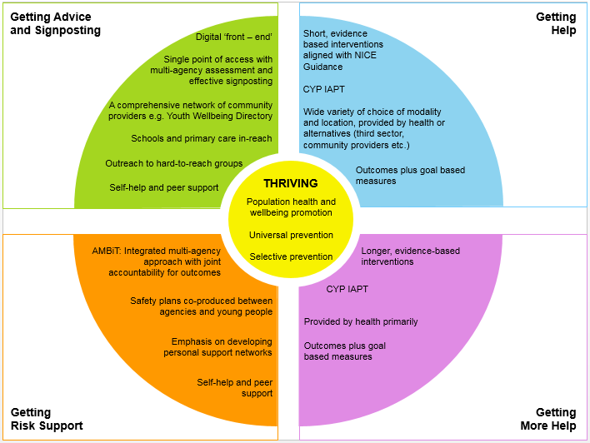
Core Components of an i-THRIVE Model of Care
Notes:
Emma

Slide 16
i-THRIVE Approach to Implementation Phase 1: Understanding Your System

Slide 17
i-THRIVE Approach to Implementation: process of implementation
Set up and governance
Engagement
Understanding your system
Prioritisation
Re-design
Implementation Planning
Structural features of Implementation
Developing Implementation teams
Workforce planning
Community of Practice
Training Clinical and Professional teams
Measurement in place
Phase 1
Phase 2
Engagement, understanding your system, and planning
Building capacity within your system
Learning from
Experience
Sustainability
Normalisation
Process Theory
Ongoing Implementation
Support Strategies
Making changes – use of Quality Improvement
Technical Assistance /Coaching/Supervision in Change Management
Supportive Feedback Mechanisms
Phase 4
Phase 3
Learning, embedding and sustaining
Implementation

Slide 18
Phase 1: Understanding Your System and Agreeing Your Priorities
1. Establishing a team who will oversee this process
Senior oversight, includes commissioners and providers of health, care and education.
2. Initial engagement with the system
Communication and engagement across the system, from senior leadership to team leads and those working with children and young people day to day.
Aim for agreement from the system, to increase awareness of issues as well as understanding of the possible approaches to improvement.
3. Analysis of your existing systems
Pathway Mapping
Data Analysis
Qualitative Understanding
4. THRIVE Baseline: How THRIVE-like are we currently?
5. Agreeing priorities for improvement
What are our collective aims?
What are the priority areas that will help us improve on these areas?
6. Transformation Design and Implementation Planning

Slide 19
i-THRIVE Approach to Implementation Phase 1: Understanding Your System Mapping Your Pathways
Notes:
Today we will do this as an exercise
When you go back and do it with your wider groups of stakeholders in your locality these you will be able to undertake these steps with them
If you need any further information before you carry out the exercise with different teams you can contact us and we’ll be happy to support

Slide 20
Mapping Your Pathways: work completed
At the last two workshops we:
Defined the scope of our pathway
Built our pathway
Reviewed the pathway as a group
Analysed the pathway from four different perspectives:
Patient experience
Operations (interactions between services and agencies)
Evidenced based interventions
Outcomes and measures
Highlighted areas of good practice, problems with quality and problems with duplication and inefficiency
Reviewed the pathway as a group again
Added in additional agencies that had previously been missed
Identified areas that needed further work or a ‘deep dive’
Notes:
It doesn’t matter if you can’t get everything set out perfectly – services will have been bolted on based on funding or priorities at different points over time so it won’t be completely logical
There is also likely to be duplication – it is the same with all sites that we undertake this exercise with

Slide 21
Mapped Pathway
[enter picture of mapped pathway]

Slide 22
i-THRIVE Approach to Implementation Phase 1: Understanding Your System Data Analysis

Slide 23
System Data Analysis: Quantitative
[enter overview of quantitative data from review of the system]

Slide 24
System Data Analysis: Qualitative
[enter overview of qualitative data from review of the system]

Slide 25
i-THRIVE Approach to Implementation Phase 1: Understanding Your System THRIVE Assessment Tool How THRIVE-like is your current system?

Slide 26
THRIVE Assessment Tool
[enter scores from THRIVE Assessment Tool (macro)]

Slide 27
THRIVE Assessment Tool
[enter scores from THRIVE Assessment Tool (meso)]

Slide 28
THRIVE Assessment Tool
[enter scores from THRIVE Assessment Tool (micro)]

Slide 29
i-THRIVE Approach to Implementation Phase 1: Understanding Your System Establishing Priorities
Notes:
Today we will do this as an exercise
When you go back and do it with your wider groups of stakeholders in your locality these you will be able to undertake these steps with them
If you need any further information before you carry out the exercise with different teams you can contact us and we’ll be happy to support

Slide 30
Agreed Top Five Priorities
[enter priority]
[enter priority]
[enter priority]
[enter priority]
[enter priority]

Slide 31
i-THRIVE Approach to Implementation Phase 1: Understanding Your System Gap Analysis
Notes:
Today we will do this as an exercise
When you go back and do it with your wider groups of stakeholders in your locality these you will be able to undertake these steps with them
If you need any further information before you carry out the exercise with different teams you can contact us and we’ll be happy to support

Slide 32
Gap Analysis
[enter overview of information captured during the gap analysis exercise]

Slide 33
i-THRIVE Approach to Implementation Phase 1: Understanding Your System Review of Agreed Priorities
Notes:
Today we will do this as an exercise
When you go back and do it with your wider groups of stakeholders in your locality these you will be able to undertake these steps with them
If you need any further information before you carry out the exercise with different teams you can contact us and we’ll be happy to support

Slide 34
Agreed Top Five Priorities
[enter priority]
[enter priority]
[enter priority]
[enter priority]
[enter priority]
Now that you have had time to think about the priorities and review the work already undertaken throughout Phase One of the i-THRIVE Approach to Implementation, does anyone feel strongly that the proposed top priorities should be changed?
Discuss as a group for 30 minutes

Slide 35
i-THRIVE Approach to Implementation Phase 1: Understanding Your System Redesign
Notes:
Today we will do this as an exercise
When you go back and do it with your wider groups of stakeholders in your locality these you will be able to undertake these steps with them
If you need any further information before you carry out the exercise with different teams you can contact us and we’ll be happy to support

Slide 36
Thinking about redesign
Successful implementation of the THRIVE principles will deliver a fully integrated system of care that leads to:
improvement in person centered care
improvement in population level outcomes
increased access to care
service efficiencies
Delivering THRIVE’s integrated system of care requires consideration of the systems being redesigned in four broad categories:
how practitioners work differently from day to day with each other and children and families
how services and pathways are organised in order to enable needs based care (the five needs based groupings)
how governance and accountability is addressed and the role of leadership to enable new working practices
how these systems are commissioned, contracted and paid for

Slide 37
What can we learn from other areas?
NHS Vanguards and New Models of Care:
New Models of Care programme at NHSEngland is committed to enabling providers and commissioners to tackle historical barriers to implementation of whole system, integrated approaches such as THRIVE.
Furthermore, there is a wealth of learning to be drawn from these ‘New Care Models’, or ‘Vanguards’ to support the development of our THRIVE-like systems, and ensure that innovations are aligned with NHSEngland’s vision of care delivery.
These new models are working to develop new approaches to bringing together health services within a locality with the aim of improving population health outcomes and delivering service efficiencies.
Their aim is to understand and tackle regulatory barriers, funding problems, address issues around accountability and governance, as well as support commissioners to develop novel approaches to contracting and payment.
Notes:
Huge amoutn of work coming out of NMC – help us think about what
Send how work is applicable

Slide 38
Which aspects are relevant to i-THRIVE?
Developing whole system, integrated care models (place based care) has required innovation in the following domains:
Creating new partnerships between provider organisations, including primary care, specialist health providers, local authority providers and providers of other statutory services (eg schools/ care homes / ambulance services etc).
The governance and organisational changes needed to support the new systems: Providers are starting to put in place more formal governance systems and partnerships so that they can work together more effectively, in particular facilitating pro-active approaches to risk.
Developing new approaches to budget management and joint commissioning
Commissioners are considering how to contract for these new models of care and, in many cases, how to work with other commissioners in so doing

Slide 39
What are these new models trying to achieve that are consistent with THRIVE’s principles?
Providing services in a different way to better meet needs, improve outcomes and reduce costs
Strengthening prevention and early intervention
Pro-active care for high risk groups
More intense support for those with higher levels of need
Who does what
Changing roles of health and social care professionals eg how to make more effective use of GPs, nurses and other professionals in community based multi-disciplinary teams
Changing where care is delivered
Care being delivered in more appropriate settings, eg close to home, in community or other providers (schools, GPs, care homes etc)
Improving co-ordination across services by overcoming institutional barriers
How different services work better together
Appropriate sequencing of interventions
Better manage transition
Plan capacity

Slide 40
Key issues to keep in mind when thinking about redesign in [enter name place]
Providing services in a different way to better meet needs, improve outcomes and reduce costs
Who does what
Changing where care is delivered
Improving co-ordination across services by overcoming institutional barriers

Slide 41
Plans for redesign
Keep in mind the work that we have done over the past couple of months in our workshops
We are going to carry out a dream, design, do exercise and then really focus on the ‘do’ by setting action points for the next six months
Group Exercise
In your group take a new piece of flip chart paper and divide it into four columns
As a whole group, decide on [enter number of tables] of the top five priorities to focus on
Each table can then chose one of the [enter number of tables] priorities to work on

Slide 42
Plans for redesign
30 minutes
Populate the first two columns with the following information:
Dream | Design
What would the ultimate dream be? This should be the priority that you have agreed to focus on – feel free to add more information about your vision for [enter place name] in relation to the priority | What should it look like? Consider how young people would view it, what the organisational structure would be, what partnerships would need to be in place, staffing, location of service, modes of delivery

Slide 43
Plans for redesign
30 minutes
Populate the second two columns with the following information:
Do | Who
What are the action points that could be undertaken in the next six months in order to progress towards what you have outlined in the design column? Remember to put a completion date next to each action point! | Who should complete the action point? Each action point should have a listed responsible person.

Slide 44
Plans for redesign: feedback
30 minutes
Feedback to the group the action points that you have agreed on to take i-THRIVE forward in [enter name place]
Are they any additional points from the other table?
Agree finalised action points

Slide 45
Next Steps

Slide 46
Next steps
Action points typed up and sent out to the group
Six month review organised
Discussion on plans for wider engagement and sharing of future steps
Plans for further work on understanding the system

Slide 47
For more information: the i-THRIVE Programme Team
Anna Moore:
i-THRIVE Lead
a.moore@ucl.ac.uk
Rachel James:
i-THRIVE Clinical Lead
rjames@tavi-port.nhs.uk
Bethan Morris:
i-THRIVE Research Officer
Bethan.morris@annafreud.org

