Slide 1
Implementing the THRIVE Framework Phase 1: Developing a full understanding of your current system

Slide 2
Our Presentation Today
Overview of the THRIVE Framework and Implementing THRIVE (i-THRIVE)
Review of pathway
Review of data collected in relation to the pathway
Top level actions to take forward

Slide 3
Overview of the THRIVE Framework for system change (Wolpert et al., 2019)

Slide 4
The THRIVE Framework for system change
The THRIVE Framework for system change (Wolpert, et al. 2019) was developed as a collaboration between the Anna Freud National Centre for Children and Families and the Tavistock and Portman NHS Foundation Trust.
Built on learning from:
Child Outcomes Research Consortium (CORC); use of patient reported outcome measures to transform practice: www.corc.uk.net
Choice and Partnership Approach (CAPA); how to manage flow and embed shared decision making: http://capa.co.uk/
Payment Systems in CAMHS development; 19 case mix adjusted groupings: http://pbrcamhs.org/final-report-published/

Slide 5
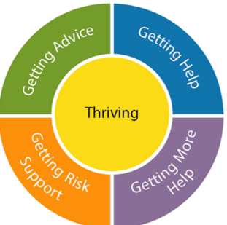
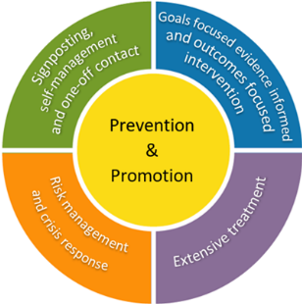
The THRIVE Conceptual Framework
Description of the THRIVE groups
Input offered
Distinction between advice/support and evidence based ‘treatment’
The five needs based groups are distinct in terms of the:
needs and/or choices of the individuals within each group
skill mix of professionals required to meet these needs
resources required to meet the needs and/or choices of people in that group
THRIVE Framework for system change (Wolpert et al., 2019)
Notes:
Rachel

Slide 6
THRIVE Framework Key Principles
Common Language
Common conceptual framework (five needs-based groupings: Thriving, Getting Advice, Getting Help, Getting More Help, Getting Risk Support) shared across all target groups.
Needs-Led
Approach based on meeting need, not diagnosis or severity. Explicit about the definition of need (at any one point, what the plan is and everyone’s role within that plan). Fundamental to this is a common understanding of the definitions of needs-based groupings across the local system.
Shared Decision Making
Voice of children, young people and families is central. Shared decision-making processes are core to the selection of the needs-based groupings for a given child or young person.
Proactive Prevention and Promotion
Enabling the whole community in supporting mental health and wellbeing. Proactively working with the most vulnerable groups. Particular emphasis on how to help children, young people and their communities build on their own strengths including safety planning where relevant.
Notes:
Rachel

Slide 7
THRIVE Framework Key Principles Continued…
Partnership Working
Effective cross-sector working, with shared responsibility, accountability, and mutual respect based on the five needs-led groupings.
Outcome-Informed
Clarity and transparency from outset about children and young people’s goals, measurement of progress movement and action plans, with explicit discussions if goals are not achieved.
Discuss the limits and ending of interventions
Differentiate treatment and risk management
Consider full range of options including self or community approaches.
Reducing Stigma
Ensuring mental health and wellbeing is everyone’s business including all target groups.
Accessibility
Advice, help and risk support available in a timely way for the child, young person or family, where they are and in their community

Slide 8
Implementing THRIVE (i-THRIVE)

Slide 9
National i-THRIVE Programme
i-THRIVE is the implementation programme that supports sites to translate the THRIVE Conceptual Framework into a model of care that fits local context.
The National i-THRIVE Programme is a collaboration between the Anna Freud National Centre for Children and Families, the Tavistock and Portman NHS Foundation Trust, Dartmouth Institute for Health Policy and Clinical Practice, and UCLPartners.
Notes:
Rachel

Slide 10
i-THRIVE Community of Practice: Offer
Funded projects:
Individual projects, e.g., Inpatient Forum,
Development of local CoP’s, e.g., Greater Manchester, Northern Ireland,
South West England
Co-ordination by i-THRIVE Programme Team:
Support sites to self-organise and manage
i-THRIVE Academy:
Learning and development support and training modules for sites
Free access to resources:
Continually evolving i-THRIVE Toolkit,
evidence based tools to aid implementation
Membership and participation is voluntary:
Promotes a “bottom-up” approach to service improvements, with dynamic multi-professional membership evolving over time
Regular interaction:
Nation-wide shared learning events, a forum for sites to share experiences about implementing THRIVE, peer support,
E-newsletters
Direct support to sites:
From the national programme team:
Includes regular liaison, coaching, consultation and practical support
i-THRIVE Illustrated:
Series of co-designed case studies highlighting how sites have approached implementing the THRIVE Framework
Notes:
Emma

Slide 11
i-THRIVE Approach to Implementation Phase 1: Understanding Your System

Slide 12
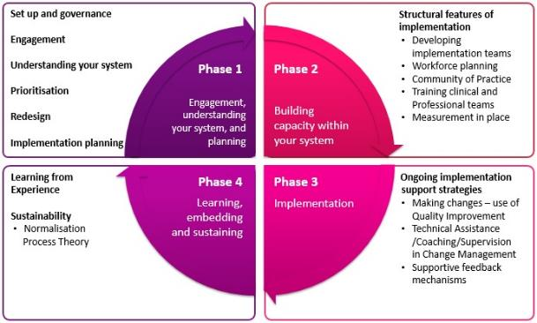
i-THRIVE Approach to Implementation
Notes:
Emma

Slide 13
Phase 1: Understanding Your System and Agreeing Your Priorities
1. Establishing a team who will oversee this process
Senior oversight, includes commissioners and providers of health, care and education.
2. Initial engagement with the system
Communication and engagement across the system, from senior leadership to team leads and those working with children and young people day to day.
Aim for agreement from the system, to increase awareness of issues as well as understanding of the possible approaches to improvement.
3. Analysis of your existing systems
Pathway Mapping
Data Analysis
Qualitative Understanding
4. THRIVE Framework Baseline: How THRIVE-like are we currently?
5. Agreeing priorities for improvement
What are our collective aims?
What are the priority areas that will help us improve on these areas?
6. Transformation Design and Implementation Planning

Slide 14
Aim for today
The THRIVE Framework is a whole system, integrated approach to care that aims to integrate health, social care and education systems, and to understand how independent and voluntary sector organisations play a part in caring for young people.
Aim for today is to review with you the data collected and discuss priorities for improving your pathway.
To help you do this we will consider:
The pathway map created at the last workshop
The data collected and what it tells us

Slide 15
Mapping Your Pathways: work completed
At the last workshop we:
Defined the scope of our pathway
Built our pathway
Reviewed the pathway as a group
Analysed the pathway from four different perspectives:
Patient experience
Operations (interactions between services and agencies)
Evidenced based interventions
Outcomes and measures
Highlighted areas of good practice, problems with quality and problems with duplication and inefficiency
Reviewed the pathway as a group again
Added in additional agencies that had previously been missed
Identified areas that needed further work or a ‘deep dive’

Slide 16
Mapped Pathway
[enter picture of mapped pathway]

Slide 17
i-THRIVE Approach to Implementation Phase 1: Understanding Your System Data Analysis

Slide 18
Data Analysis
Developing a map of your existing pathways is an important first step to understanding how your system is working currently
A critical second step is to understand how this is functioning:
How does this pathway impact on patient outcomes?
Does the structure of the pathway enable us to meet basic standards around access and waiting times?
Is it an efficient system?
Does the way the pathway functions put pressure on any particular parts of the system, e.g. primary care or education?
What do children, young people and parents think of the way the system currently works?
Are there any parts of the pathway have unintended consequences, such as children and young people receiving poor care?

Slide 19
Data and Discussion
Over the next few slides we will present some graphs which help show how children and young people are moving though your pathways
This information has been collected by [enter name] and relates to [enter services names]
This data relates to all children and young people receiving support during [enter time period]
[enter any further statements about the data]

Slide 20
System Data Analysis: Quantitative
[enter overview of quantitative data from review of the system]

Slide 21
System Data Analysis: Quantitative
[enter overview of quantitative data from review of the system]

Slide 22
System Data Analysis: Quantitative
[enter overview of quantitative data from review of the system]

Slide 23
System Data Analysis: Quantitative
[enter overview of quantitative data from review of the system]

Slide 24
System Data Analysis: Quantitative
[enter overview of quantitative data from review of the system]

Slide 25
System Data Analysis: Quantitative
[enter overview of quantitative data from review of the system]

Slide 26
System Data Analysis: Quantitative
[enter overview of quantitative data from review of the system]

Slide 27
Data and Discussion: Groups
You will now review the data presented in smaller groups
45 minutes
As a group discuss the following points:
Does the data presented reflect your personal experiences of the local system?
Are there any surprises in the data presented?
Is there anything that needs further contextual investigation?
Is the data for your local system in line with national benchmarking?
What data is missing?
Feedback: 30 minutes
Each table feeds back their key points to the group as a whole
Comments on the points shared by each table

Slide 28
Data and Discussion: actions to take forward
Based on the group discussions and the feedback we will now identify any further investigation that needs to be undertaken
What do we need to look into further?
What additional data do we need to collect?
Do we have data from all agencies involved in supporting children and young people?
15 minutes
List all actions to take forward on flipchart paper

Slide 29
Next Steps

Slide 30
Next steps
Action points typed up and sent out to the group
Qualitative review of the system undertaken
Plans for further work on understanding the system including the THRIVE Assessment Tool and agreeing priorities to take forward
Redesign workshop

Slide 31
For more information: i-THRIVE
www.implementingthrive.org
Sign up to the National i-THRIVE Community of Practice and receive monthly newsletters. Email Bethan Morris at:
bmorris@tavi-port.nhs.uk
@iTHRIVEinfo

